Slide 1
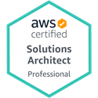
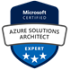
IoT and Edge Computing in the Cloud
CNM Ingenuity IoT Bootcamp
22 March 2024
John M. Linebarger, PhD, MBA
Principal Member of Technical Staff
Sandia National Laboratories
SAND2022-6180 C
Sandia National Laboratories is a multimission laboratory managed and operated by National Technology and Engineering Solutions of Sandia, LLC, a wholly owned subsidiary of Honeywell International Inc., for the U.S. Department of Energy’s National Nuclear Security Administration under contract DE-NA0003525.

Slide 2
Outline
Overview of the Cloud
Background
What, How, Why, Who, Where
IoT (Internet of Things) vs. Edge Computing
IoT Computing
AWS (Amazon Web Services)
Microsoft Azure
Edge Computing
Cloud-based (AWS)
Non-cloud-based: Flood Control System Proof-of-Concept
Q&A

Slide 3
Overview of the Cloud

Slide 4

Virtual Machines vs. Containers
Virtualize the Hardware (Infrastructure)
Containers Package Apps + Dependencies;
Virtualize the Operating System.
https://www.weave.works/blog/a-practical-guide-to-choosing-between-docker-containers-and-vms
Notes:
Each technology virtualizes the layer it sits on.
Virtualization allows a physical resource to be multiplexed across several virtual resources.
Containers are lightweight and start up on the order of seconds. VMs are more heavyweight and start up on the order of minutes.
Types of virtual machines: Hyper-V (Windows), QEMU (software-based), KVM (hardware-based), VMware, VirtualBox (Oracle).
https://www.makeuseof.com/best-virtual-machine-linux-kvm-virtualbox-qemu-hyper-v/
By far the most dominant OS used in a VM is Linux, but Windows and MacOS VMs are used as well.
Types of containers: Docker, Podman, containerd, runC, LXC (Linux), CRI-O, rkt. Also Windows Containers and Hyper-V Containers.
https://k21academy.com/docker-kubernetes/what-are-containers/

Slide 5
Cloud Service Categories
Known VM, accessible, your code
Infrastructure-as-a-Service (IaaS)
Virtual machines with full access and responsibility
Software-defined networking and security
Platform-as-a-Service (PaaS)
Deploy code on cloud platform with no access to server
Software-as-a-Service (SaaS)
Run application directly on cloud (e.g., Google Workspace)
Serverless (short, stateless, event-driven)
Function-as-a-Service (FaaS) [code]
Container-as-a-Service (CaaS) [container]
Workflow-as-a-Service (WaaS) [graphical workflow]
Managed Service
Serverless service from cloud vendor
Known VM, inaccessible, your code
Unknown VM, inaccessible, your data
Unknown VM, inaccessible, your code
Unknown VMs, inaccessible, vendor’s code
Notes:
In all cases, the actual physical server is unknown and inaccessible (except for special cases of bare metal and dedicated host offerings by the cloud vendor)

Slide 6
What is Cloud (Definition)?
Ontological: Illusion of infinite remote data and computing resources
Functional
Elasticity (illusion of infinitely agile resources)
Resiliency (High Availability/Disaster Recovery; illusion of omnipresence)
Demand-driven/Consumption-based (illusion of infinite control)
Technical
Software-defined (illusion of infinite flexibility)
Virtualized (illusion of exclusivity)
Internet-accessible (illusion of ubiquity)
Notes:
Fundamentally, Cloud is an Illusion.

Slide 7
How is Cloud (Paradigms)?
Cloud Service Provider
Orchestrated Containers
Generally proprietary IaaS/PaaS from provider
Rich ecosystem of cloud services mostly from a single cloud vendor
Global infrastructure with classification tiers
Examples:
Public hyperscale cloud (AWS, Azure, GCP, Oracle, IBM)
Public VPS cloud: DigitalOcean
Private cloud (OpenStack, Azure Stack, AWS Outposts)
Private cloud that orchestrates containerized applications (pods)
App-level cloud (vs. infrastructure)
Richer ecosystem of multi-vendor services
Under Cloud Native Computing Foundation; usually open source.
Examples:
Kubernetes; Docker Swarm.
Enterprise-hardened K8s distros (OpenShift, Rancher [RKE2 for Government])
Notes:
VPS: Virtual Private Server
Another example of a Virtual Private Server public cloud is OVHcloud. Salesforce seems to be a SaaS cloud provider that serves specific industries with specific applications. Salesforce migrated its Marketing Cloud platform to AWS.
OpenStack is a bit of an exception because it is an open source Private Open Source Cloud that follows the Public Cloud Vendor (cloud service provider) model. NASA et al. consciously followed the Amazon AWS model when they created OpenStack around EC2-like VMs and S3-like object storage.
CNCF: Cloud Native Computing Foundation.
CNCF certification curriculum links: https://github.com/cncf/curriculum.
K8s is abbreviation of Kubernetes (‘8’ replaces the eight characters between the K and the s)
The irony, of course, is that the word “cloud” is officially associated with only one of these paradigms, as is the concept of “cloud native.” Cloud First, Cloud Smart, and Cloud Native are loaded terms.
The most popular container orchestrator, Kubernetes, originated at Google. Docker Swarm is another orchestrator. So is Apache Mesos.
https://semaphoreci.com/blog/docker-swarm-kubernetes
Probably because of its Google heritage, the fundamental system software for the CNCF orchestrated containers cloud paradigm is largely written in the Go programming language: Kubernetes, Docker, Helm, Istio. Also Prometheus, Grafana, Terraform, Etcd. And the Kubernetes utilities kubectl and eksctl.
https://github.com/eksctl-io/eksctl
Some have even called Go the programming language of the cloud.
https://thenewstack.io/go-the-programming-language-of-the-cloud/
https://thechief.io/c/editorial/why-golang-is-widely-used-in-the-devops-and-cloud-native-space/

Slide 8
Why is Cloud (Value Proposition)?
Benefits
Transforms Capital Expenses (CapEx, on balance sheet) into Operating Expenses (OpEx, on income statement)
E.g., steady-state Sponsor budget may not support CapEx spikes
Much computing and security logistics become somebody else’s problem (“undifferentiated heavy lifting”)
Focus on business value by outsourcing implementation logistics
Availability of infinitely elastic resources from somebody else
Recapitalization becomes reconfiguration
Use cases
Startups that cannot afford or staff their own data center
New product launch with unpredictable or spiky demand
Flexible sandbox for prototyping and proofs of concept
Difficulty recruiting and retaining highly skilled IT personnel
Government agency following Government directives
Buy vs. Rent
Shared Responsibility Model
Notes:
In the cloud you can always get three wishes more

Slide 9
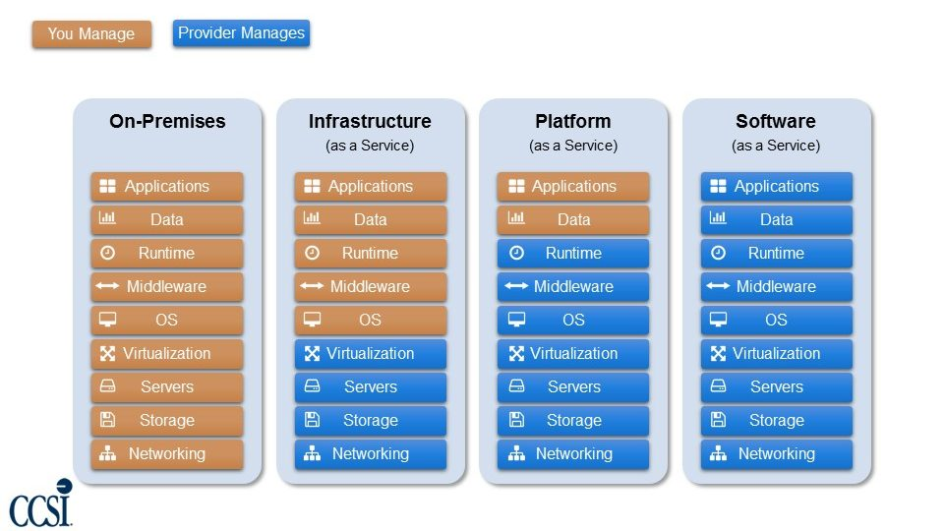
Shared Responsibility (Management)
https://securityboulevard.com/2018/02/cloud-computing-basics/

Slide 10
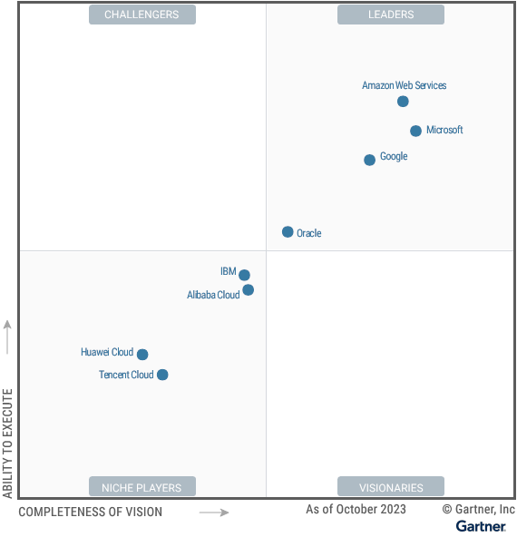
Who is Cloud (Hyperscale CSP)?
Notes:
CSP: Cloud Service Provider.
Gartner changed the name of their Magic Quadrant in 2023 from Cloud Infrastructure and Platform Services (CIPS) to Strategic Cloud Platform Services (SCPS). But theirs is the dominant market scorecard for public cloud IaaS and PaaS services.
In existence for over a decade, AWS has been designated as the leader the entire time.
Not money or survey-based like following charts but based on Gartner’s experience and professional judgement.
The US-based cloud providers are referred to at least by the DoD as “hyperscale cloud vendors.” Some include Alibaba in that list; recent Alibaba television ads have tried to tout how American Alibaba is, and how it benefits Americans, perhaps in an attempt to compensate for its Chinese origins.
https://www.digitalocean.com/resources/article/hyperscaler-cloud
IBM seems to have established a market niche in the hybrid cloud, perhaps due to their mainframe heritage.
https://www.gartner.com/doc/reprints?id=1-2FTDYPQN&ct=231204&st=sb
https://aws.amazon.com/resources/analyst-reports/gartner/global-mq-ardm-23-magic-quadrant-for-strategic-cloud-platform-services/
https://azure.microsoft.com/en-us/blog/microsoft-named-a-leader-in-2023-gartner-magic-quadrant-for-strategic-cloud-platform-services-scps/

Slide 11
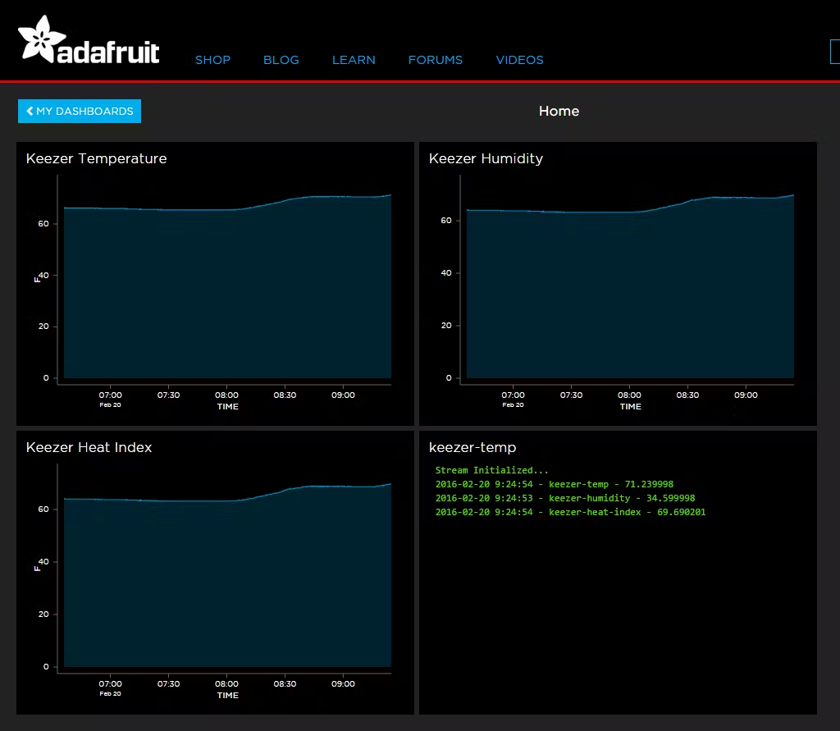
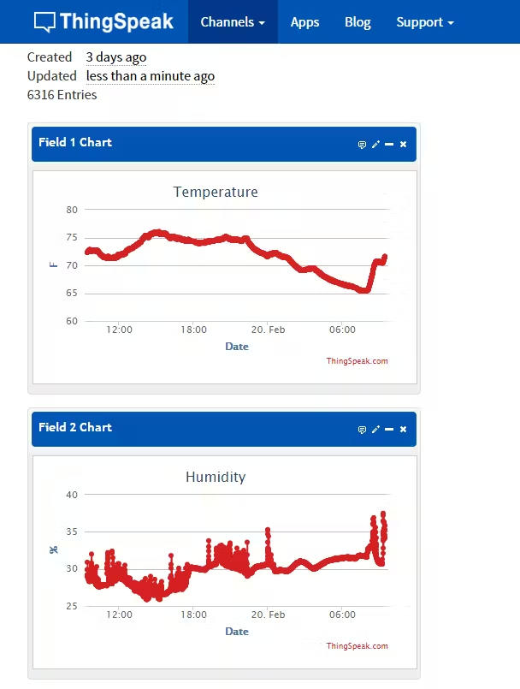
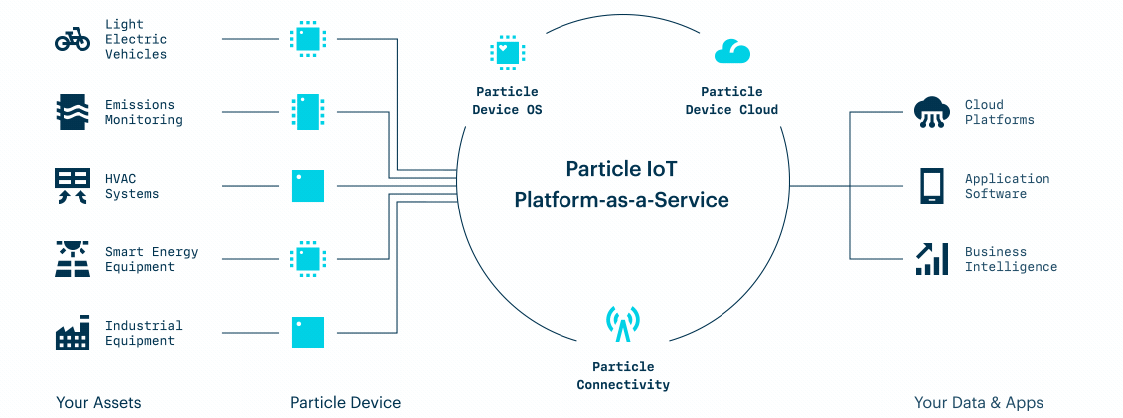
Who is Cloud (IoT CSP)?
adafruit.io
ThingSpeak
Particle Device Cloud
Notes:
https://www.hackster.io/nicjansma/particle-photon-remote-temperature-and-humidity-logger-00dd00
The IoT Deep Dive Bootcamp class might be sending their Photon 2 IoT data to the Particle Device Cloud.

Slide 12
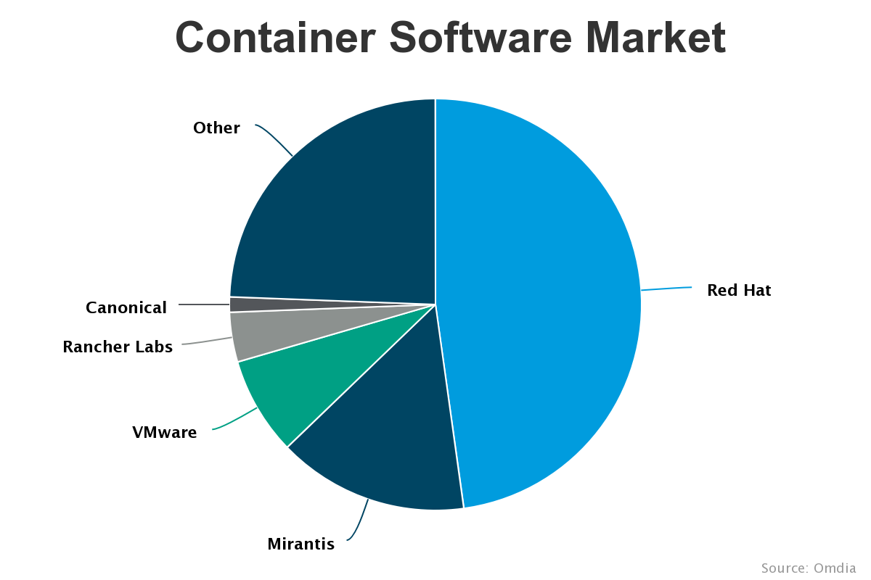
Who is Cloud (Orchestrated Containers)?
Notes:
The major Enterprise-grade Kubernetes players are Red Hat OpenShift, Mirantis Kubernetes Engine, VMware Tanzu Kubernetes Grid, Rancher, and Canonical Charmed Kubernetes. “Other” is probably vanilla Kubernetes.
Source (from 2021): https://www.itprotoday.com/containers/whos-winning-container-software-market
An instructive (though biased) comparison
https://ubuntu.com/kubernetes/compare
https://www.infoworld.com/article/3265059/6-kubernetes-distributions-leading-the-container-revolution.html
(Same vendors as graph in slide but added Docker because it recently announced it was adding Kubernetes to its distributions.)

Slide 13
Where is Cloud (Global Infrastructure)?
Regions
Geopolitical and/or data sovereignty boundaries
Special Regions are Government, Classified, or Isolated
Pricing is Regional, including inter-Region data transfer
Disaster Recovery (DR) means failing over to another Region
Availability Zones
AZs (data centers) within a Region intentionally have separate electrical grids, flood plains, network infrastructure
High Availability (HA) means utilizing multiple AZs in Region
Global Network Backbone
Fiber optic networking over land lines and undersea cables
High-speed, generally custom-designed, network devices
For decreased latency and jitter, architect systems to keep network traffic on the backbone as much as possible.
Can manually implement Zones in Kubernetes
Must also architect cloud services calls to stay on backbone
Notes:
A global network backbone and globally-accessible services are what defines a hyperscale cloud provider.
For the hyperscale cloud service providers, cloud is a side-effect:
AWS is the cloud that online bookselling built
Azure is the cloud that Windows and Office built
GCP is the cloud that search built
OCI is the cloud that database built
IBM is the cloud that mainframes built
This is not the case for the much smaller, non-hyperscale cloud service providers such as Salesforce and DigitalOcean. Hetzner Cloud also has a presence; it is based in Germany.
https://community.hetzner.com/
https://accounts.hetzner.com/login

Slide 14
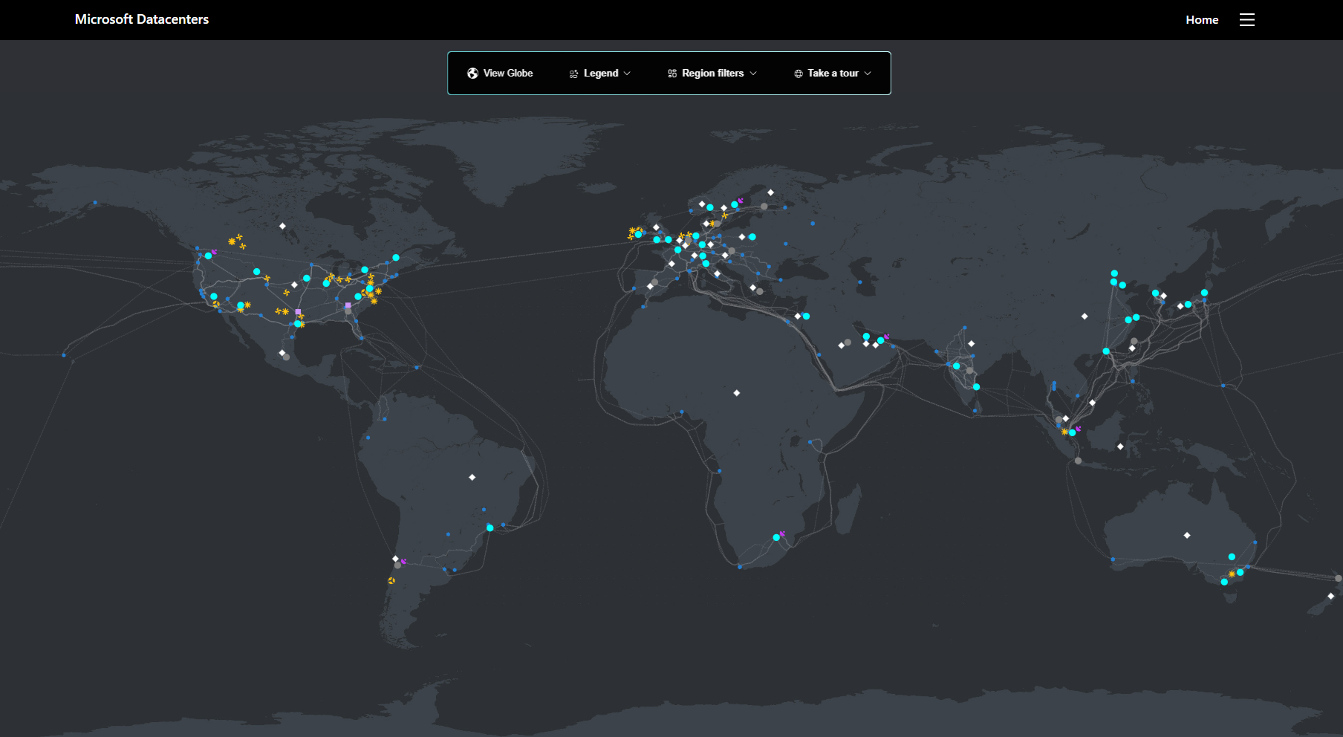
Regions and Availability Zones: Azure
https://datacenters.microsoft.com/globe/explore
Notes:
Interactive demo: https://datacenters.microsoft.com/globe/explore
AWS version: https://aws.amazon.com/about-aws/global-infrastructure/, https://aws.amazon.com/about-aws/global-infrastructure/regions_az/

Slide 15
IoT vs. Edge Computing

Slide 16
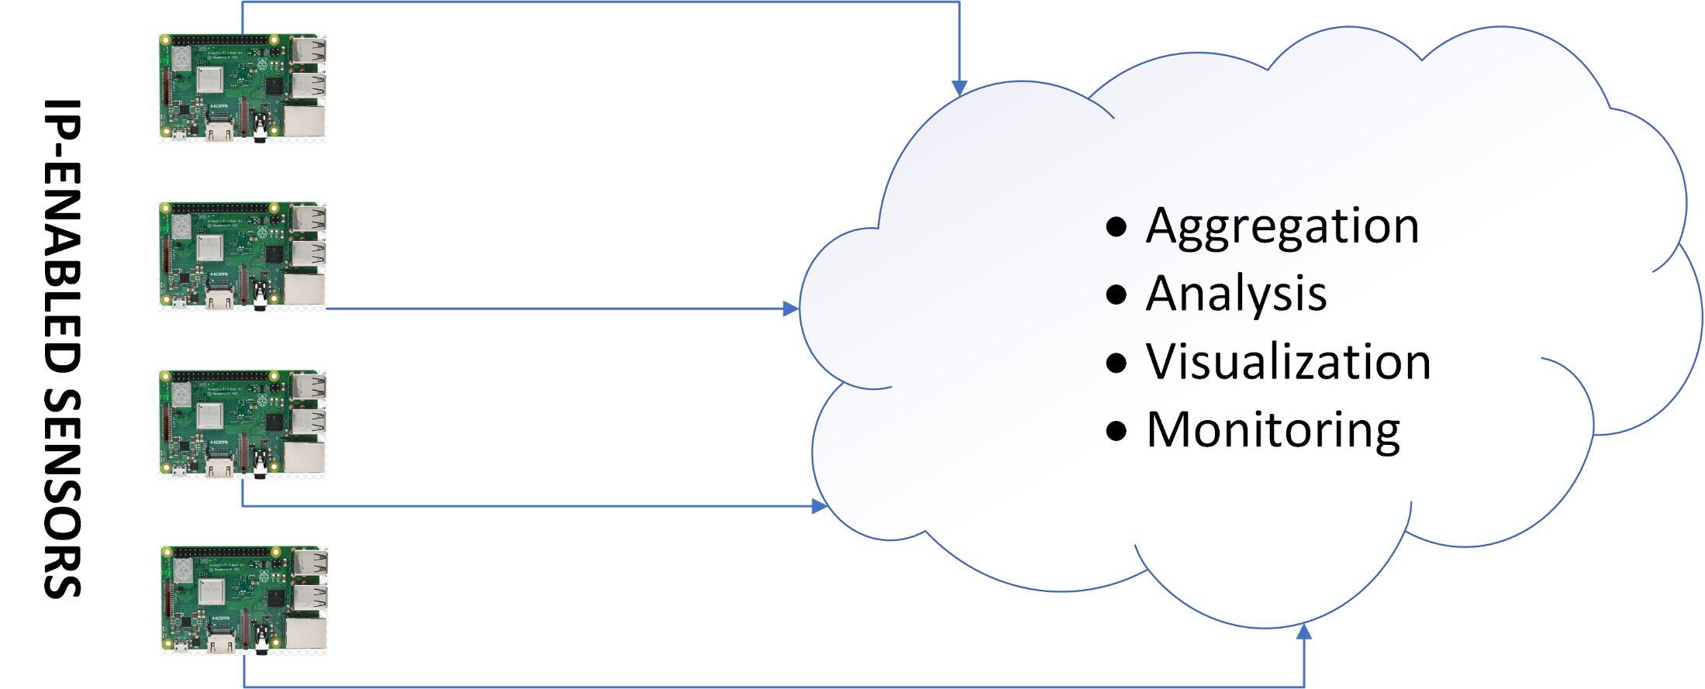
IoT Computing Paradigm
Notes:
IoT devices talk directly to the cloud. The cloud is where all computation takes place.

Slide 17
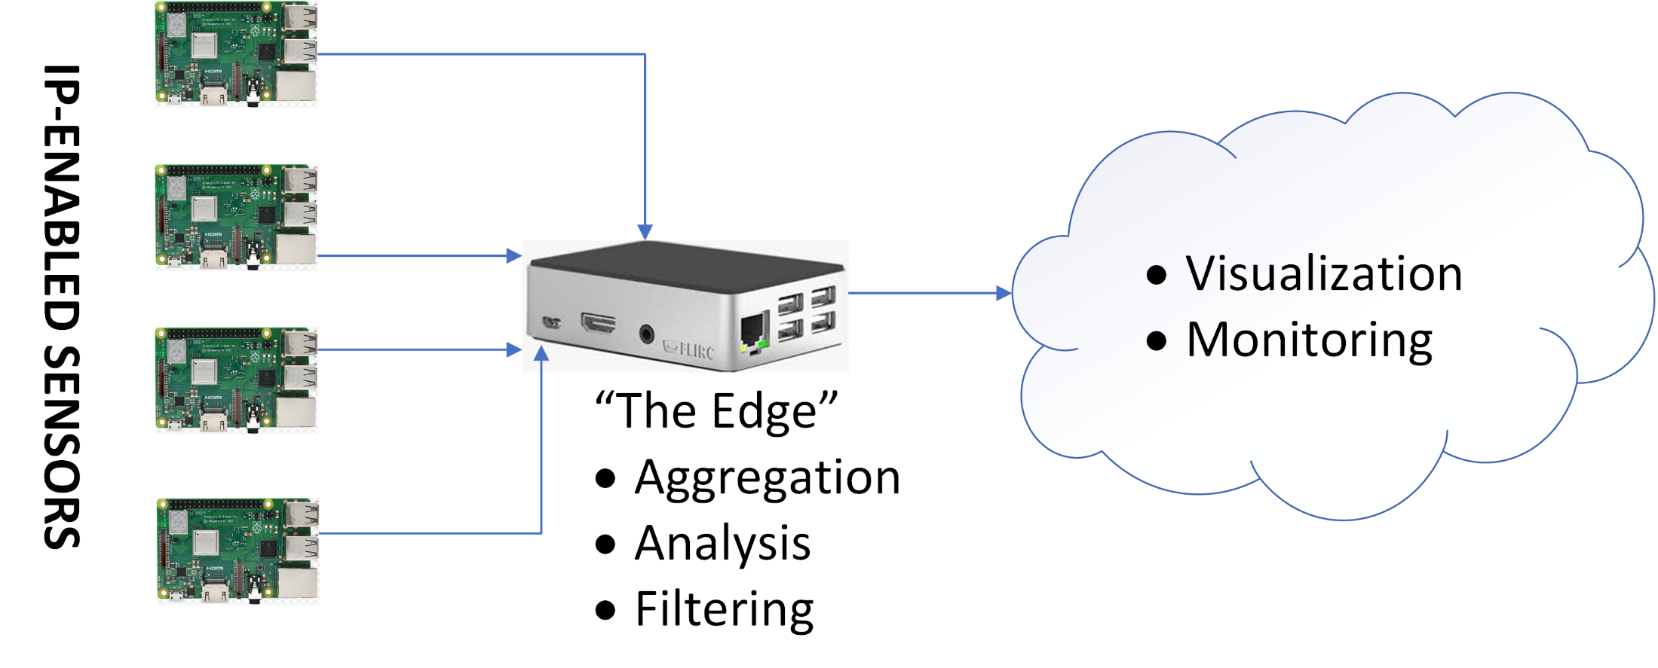
Edge Computing Paradigm
Notes:
Think of the Edge as being one hop away from the cloud. The IoT devices talk to the Edge instead of directly to the cloud. Only the Edge device talks to the cloud. The IoT devices are often collocated with the Edge in some way, at least relative to the cloud (i.e., factory floor, in-theater).
Computation is split between the Edge device and the cloud. Connection between the Edge and the cloud could be intermittent.

Slide 18
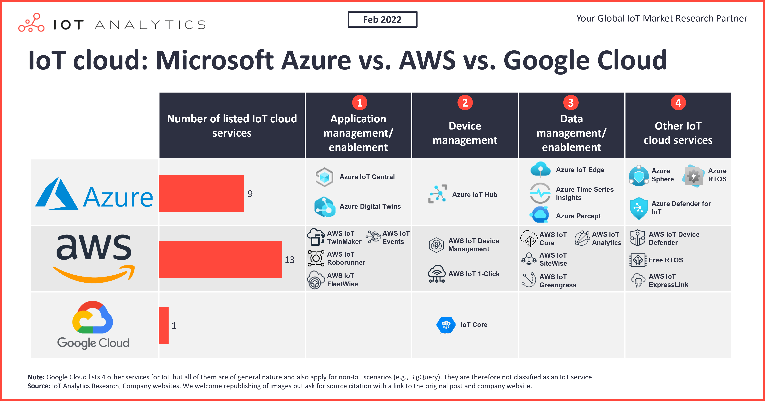
Hyperscale Multicloud for IoT/Edge
https://iot-analytics.com/iot-cloud/
Notes:
Comparisons (but many want to sell IoT consulting services to tailor the choice to your company):
https://www.linkedin.com/pulse/aws-iot-vs-azure-choose-your-best-solution-wellnutscg
“Some say that AWS offers more comprehensive and advanced services. Meanwhile, Azure is easier to start with and more convenient for small businesses.”
https://relevant.software/blog/aws-vs-azure-for-iot/
“[I]f you’re looking for a comprehensive IoT platform for an IoT project of any size, lean toward AWS.”
https://www.techrepublic.com/article/aws-vs-azure-industrial-iot/
“If you are looking for an IIoT solution that is sophisticated and comprehensive but still fits any project size, AWS platform for IIoT will be a better fit. If you are more inclined to go for a more user-friendly solution for your team, then you should consider Microsoft Azure.”
In short, go with AWS if you have power user needs and want a comprehensive solution; go with Azure if you are just starting out and want a more user-friendly solution.

Slide 19
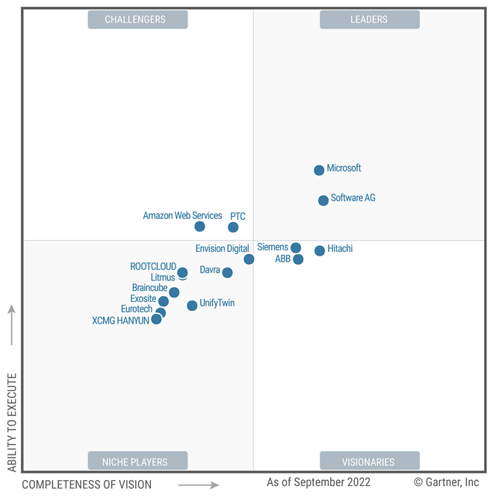
Gartner “Magic Quadrant” for IIOT
Notes:
IIOT – Industrial IoT
2022 Gartner Magic Quadrant for Global Industrial IoT Platforms
https://azure.microsoft.com/en-us/blog/microsoft-named-a-leader-in-the-2022-gartner-magic-quadrant-for-industrial-iot-platforms/

Slide 20
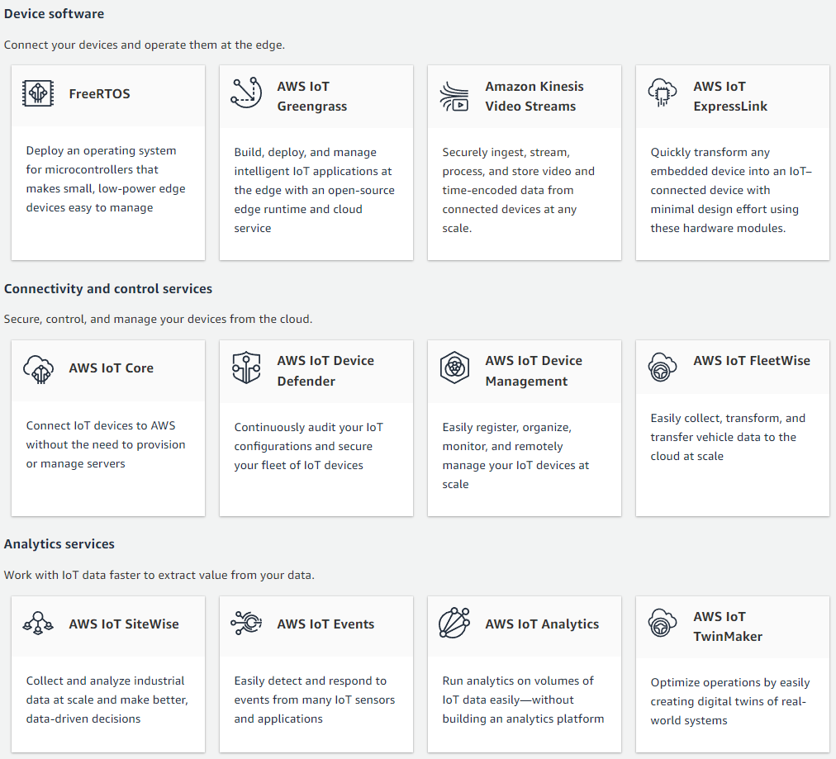
AWS IoT Services Ecosystem
https://aws.amazon.com/iot/
Notes:
https://www.leewayhertz.com/build-iot-app-aws-iot/
https://mobidev.biz/blog/iot-application-development-with-the-aws-iot-platform

Slide 21
IoT Computing

Slide 22
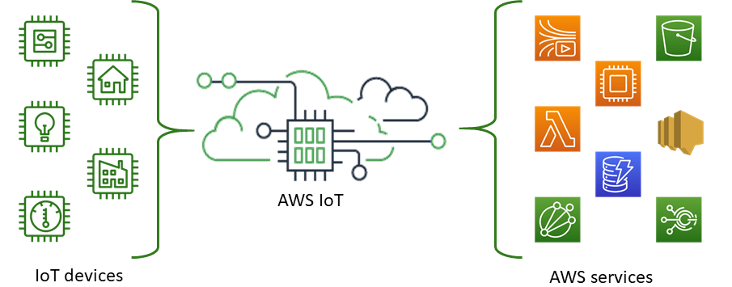
IoT Computing in AWS
AWS has a rich set of Console-based IoT services as well as device SDKs
v1.4.9 of the Python IoT SDK was used because it bundles v1.11 of Greengrass Edge Computing SDK instead of v2.x.
Image Source: https://docs.aws.amazon.com/iot/latest/developerguide/what-is-aws-iot.html
Notes:
SDK: Software Development Kit.
Device SDKs are by language, not by particular IoT device. Open source and available on GitHub.
I’ll talk about Greengrass, and why I wanted that particular version, later on in the presentation.

Slide 23
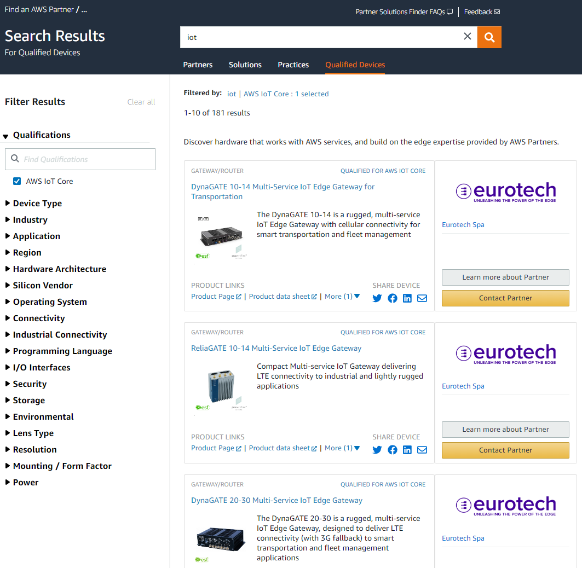
Finding AWS IoT Qualified Devices
Notes:
https://partners.amazonaws.com/search/qualified-devices/?keyword=iot
AWS has a formal Device Qualification Program

Slide 24
AWS IoT Computing Architecture
Legacy acronym; now just a name. AWS IoT Core is MQTT broker.
MQTT (Message Queuing Telemetry Transport) pub/sub JSON messages used for device communication; optimized for low bandwidth/high latency environments
Each IoT device (called a Thing) has a Shadow that the cloud can populate with a Desired value and the device can populate with a Reported value using MQTT and an HTTPS REST API endpoint
Things can be typed and grouped
Device-specific PKI certs and associated IAM policies used for security
Helpful when IoT device loses connection with the cloud
Notes:
JSON: JavaScript Object Notation
Delta between Desired and Reported seems to be automatically calculated.

Slide 25
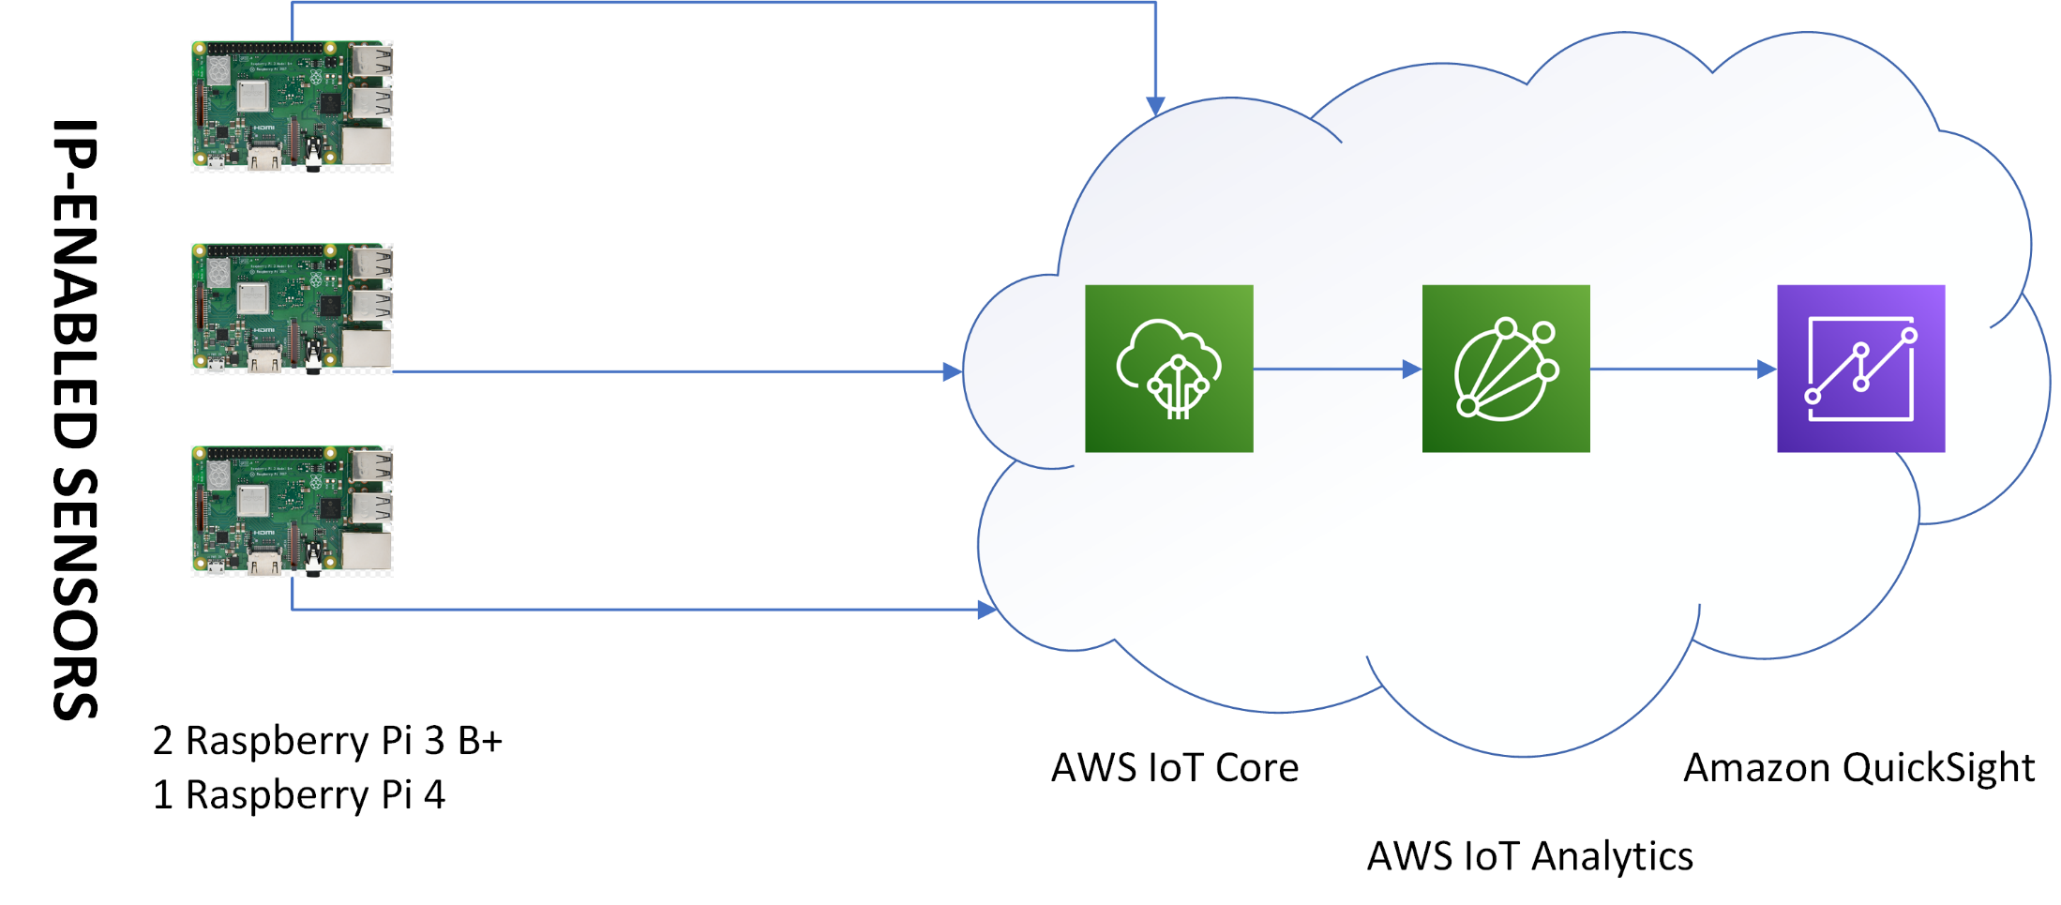
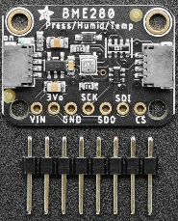
IoT Prototype Architecture
BME280 Temperature/ Barometric Pressure/ Humidity / (Altitude)
Digital Sensor
Notes:
IoT experiment sensor: BME280 in I2C mode
https://learn.adafruit.com/adafruit-bme280-humidity-barometric-pressure-temperature-sensor-breakout
‘sudo i2cdetect -y 1’ on Raspberry Pi used to detect presence of an I2C sensor
Originally I soldered it to the leads and pressed it into a breakout board, but got smart and used one of the STEMMA QT connectors on the sensor instead.

Slide 26
IoT Computing Prototype
Requires Inter-Integrated Circuit (I2C) protocol support on each Raspberry Pi
3 Raspberry Pis with GPIO / I2C digital sensor data sent to IoT Core
IoT Analytics created data table (dataset) from the data auto-pushed by IoT Core
QuickSight manually pulled & visualized dataset
Data from Raspberry Pi:
CPU temperature
Average CPU percent
Number of processes
WiFi signal quality
Data from GPIO / I2C sensor:
Ambient temperature
Ambient humidity
Ambient barometric pressure
Altitude (calculated)
Notes:
Data pushed from IoT Core to IoT Analytics via an Action on a Rule in IoT Core.
GPIO: General-Purpose Input/Output
I2C: Inter-Integrated Circuit, pronounced I-squared-C. A bus interface connection protocol for serial communication.
“[A] synchronous, multi-master, multi-slave, packet switched, single-ended, serial communication bus invented in 1982 by Philips Semiconductor (now NXP Semiconductors). It is widely used for attaching lower-speed peripheral ICs to processors and microcontrollers in short-distance, intra-board communication.”
https://en.wikipedia.org/wiki/I%C2%B2C
Raspberry Pi must be configured to support I2C. That allows the I2C protocol to be used on two special GPIO pins in the 40-pin connector.
Average CPU percent is across the four cores of the Raspberry Pi

Slide 27
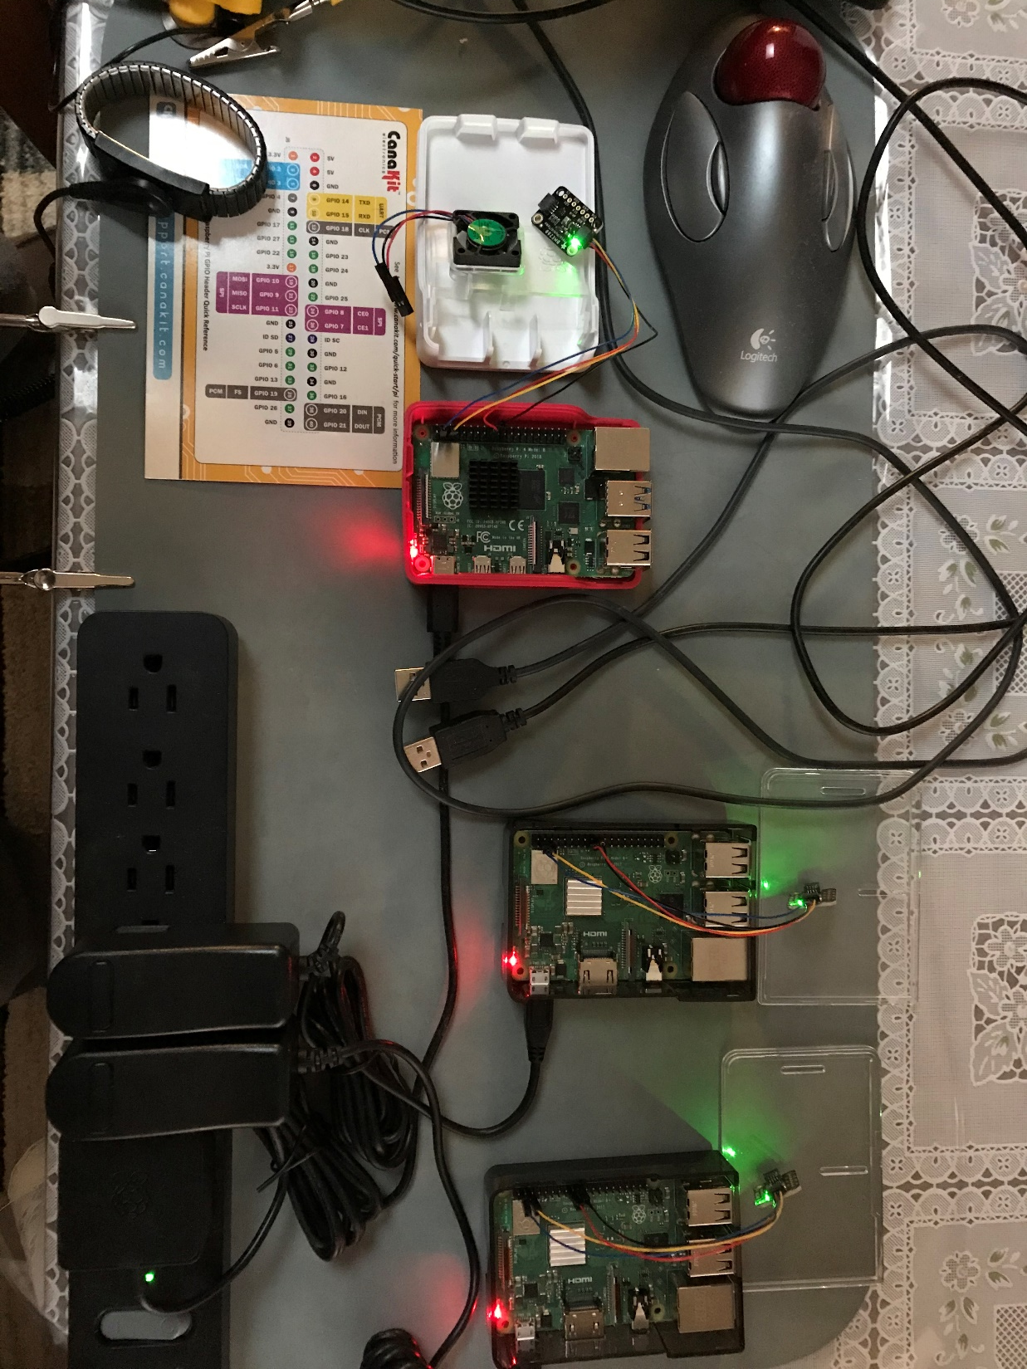
Raspberry Pi IoT Computing Lab
Notes:
The sensor is digital, which makes I2C connection to the Raspberry Pi easy.

Slide 28
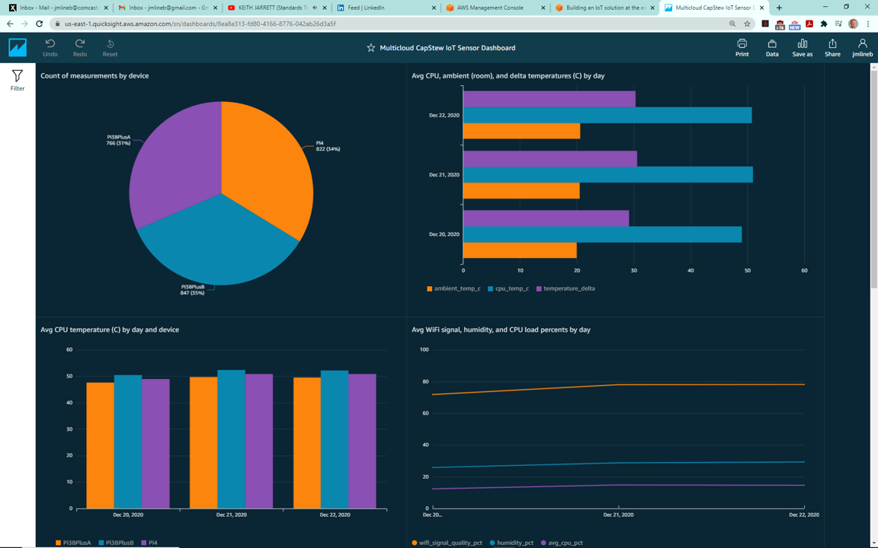
Results: QuickSight Dashboard

Slide 29
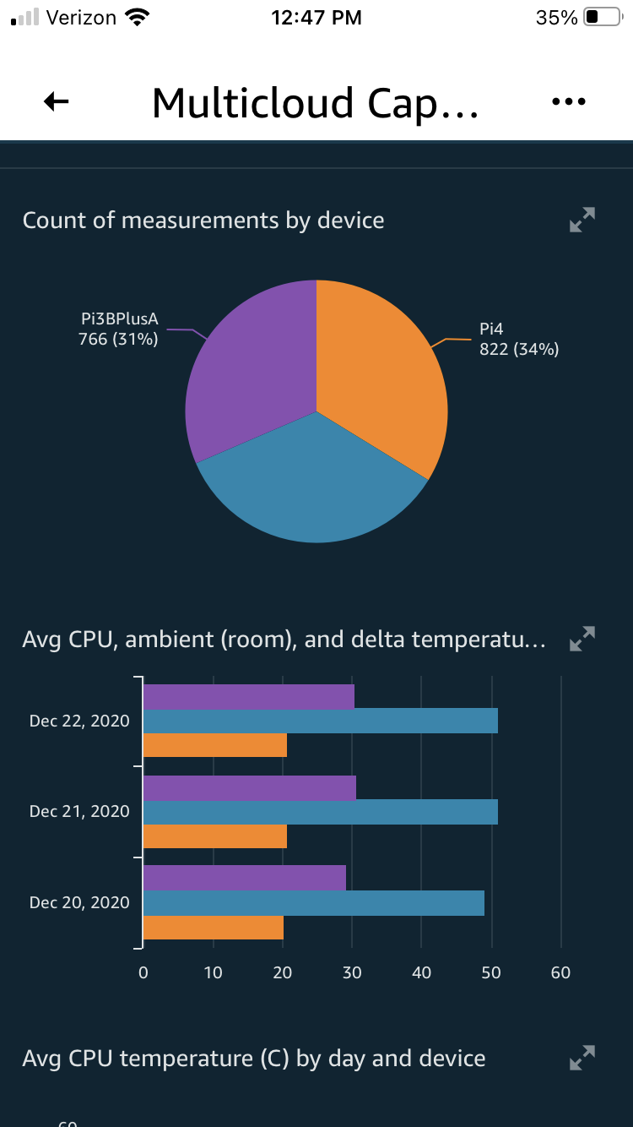
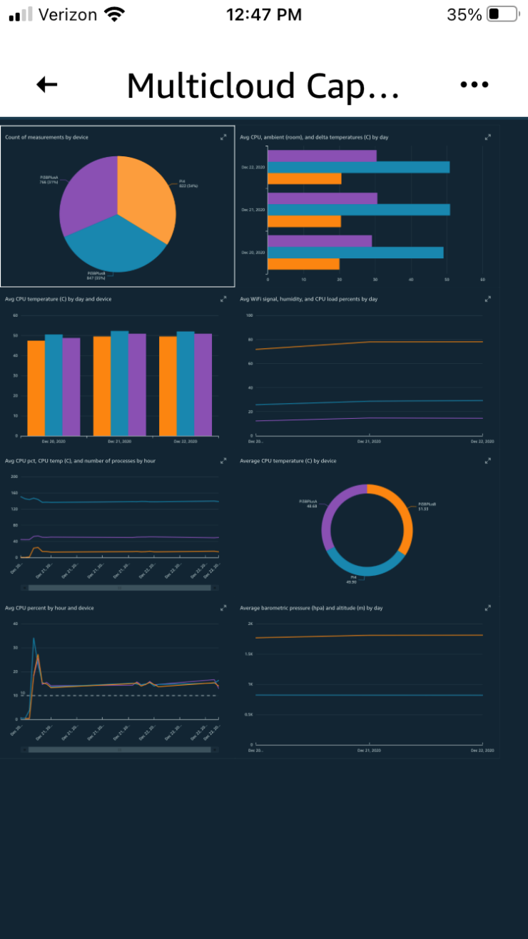
Results: QuickSight Mobile App

Slide 30
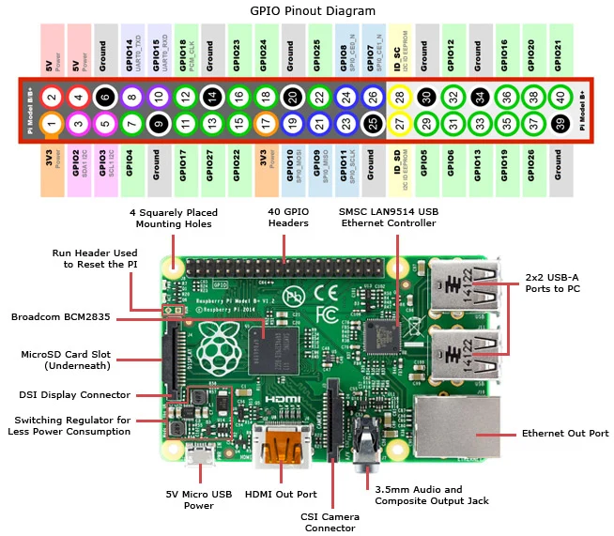
Mechanics: Raspberry Pi Sensor I/F
Notes:
Unlike the Arduino microcontroller, which has analog pins as well, all of the pins on a Raspberry Pi are digital.
Image Source depicts a Pi 3 Model B: https://www.jameco.com/Jameco/workshop/circuitnotes/raspberry-pi-circuit-note.html
General Raspberry Pi sensor I/F protocol information:
SPI vs I2C: https://electronics.stackexchange.com/questions/37814/usart-uart-rs232-usb-spi-i2c-ttl-etc-what-are-all-of-these-and-how-do-th
SPI vs I2C vs GPIO: https://www.reddit.com/r/ECE/comments/hzksx/can_someone_explain_the_difference_between_i2c/

Slide 31
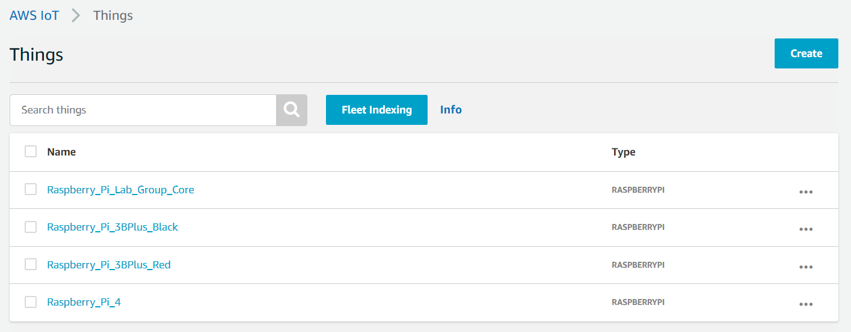
Mechanics: Things (IoT Devices)

Slide 32
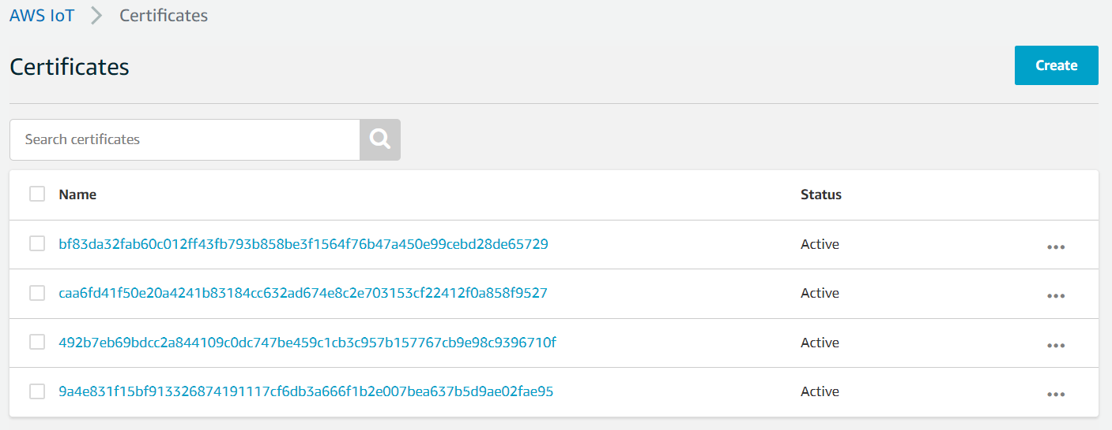
Mechanics: PKI Certs
Notes:
Certs have to be installed on the IoT devices

Slide 33
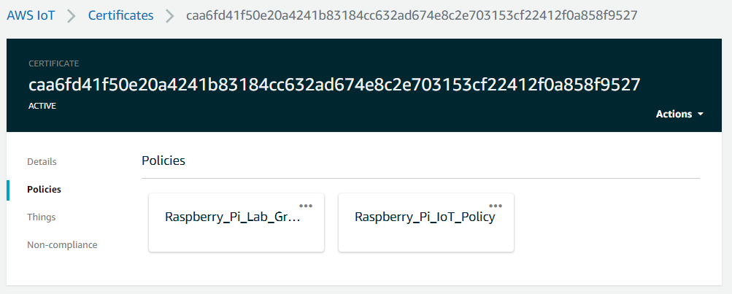
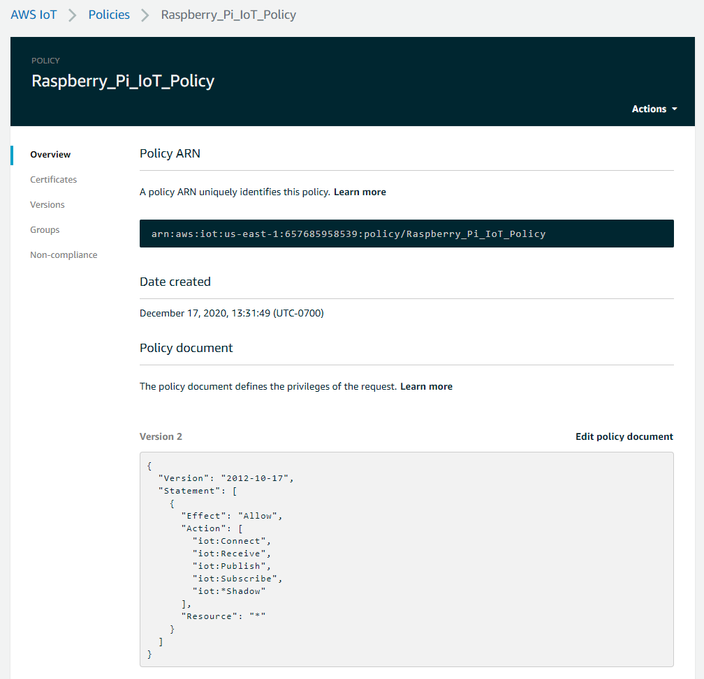
Mechanics: PKI Certs with IAM Policies
Notes:
Certs are associated with IAM policies to allow the IoT device to connect to the cloud and grant authorization to access cloud resources

Slide 34
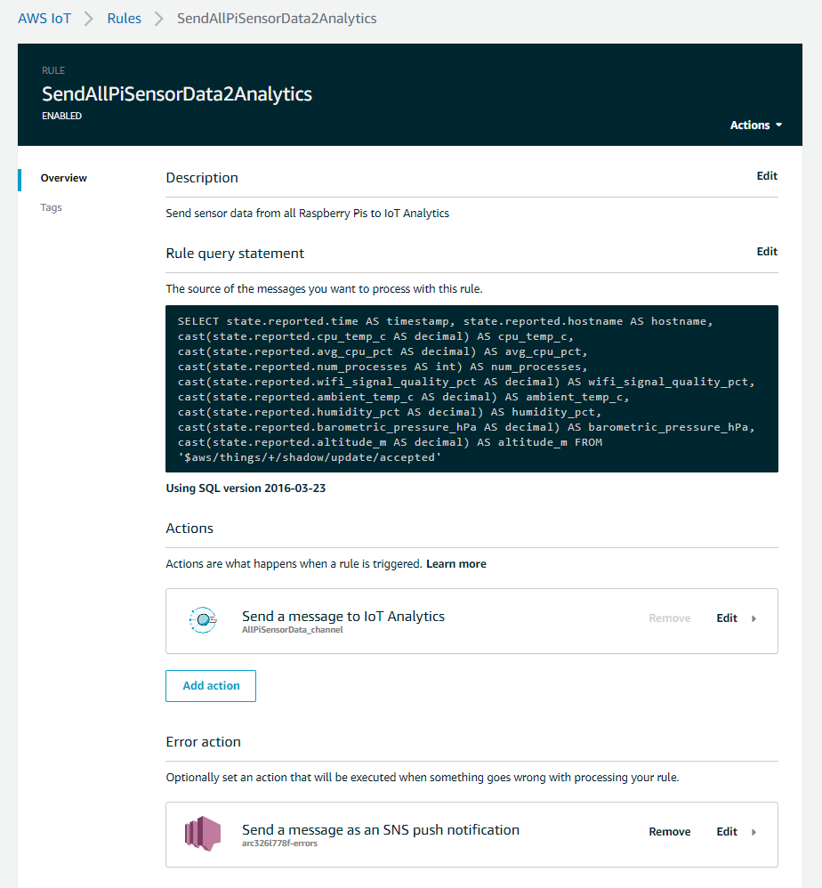
Mechanics: Auto Push to IoT Analytics
Notes:
Every time a Thing shadow MQTT update message is received, this SQL statement in an IoT Core Rule automatically pushes the data to a channel in IoT Analytics.

Slide 35
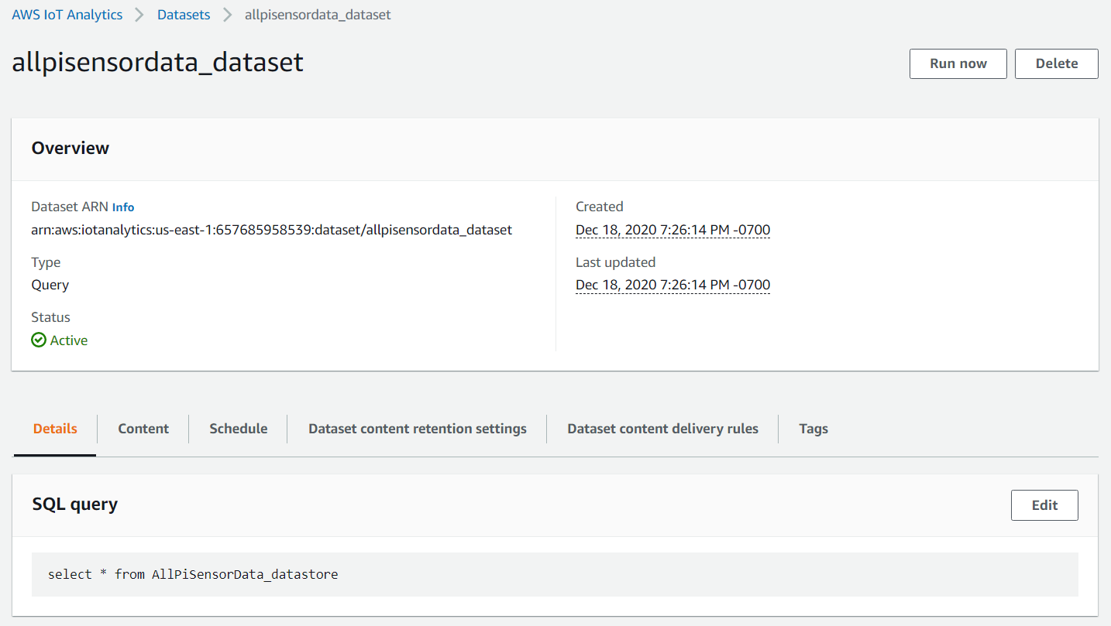
Mechanics: Pull to Analytics Dataset
Notes:
This is a manual pull of data sent to the channel through the (default) pipeline and data store, initiated by Run now at the dataset level.
Can refresh a dataset with a specified schedule frequency using SQL queries against the data store.
Data automatically pushed to a channel but manually pulled into a data store.

Slide 36
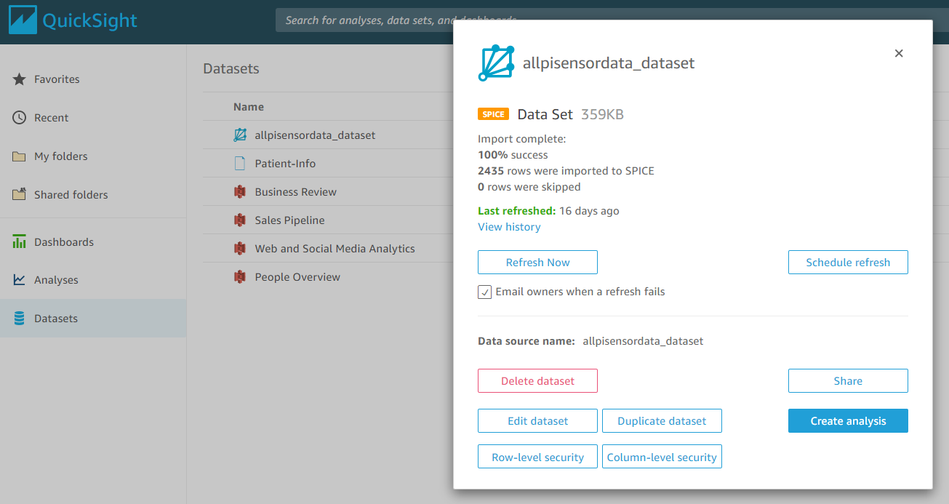
Mechanics: Refresh QuickSight
Notes:
This data refresh is also done manually, in QuickSight. A manual pull from a data store to a dataset. It can be automatically scheduled according to a specified frequency.

Slide 37
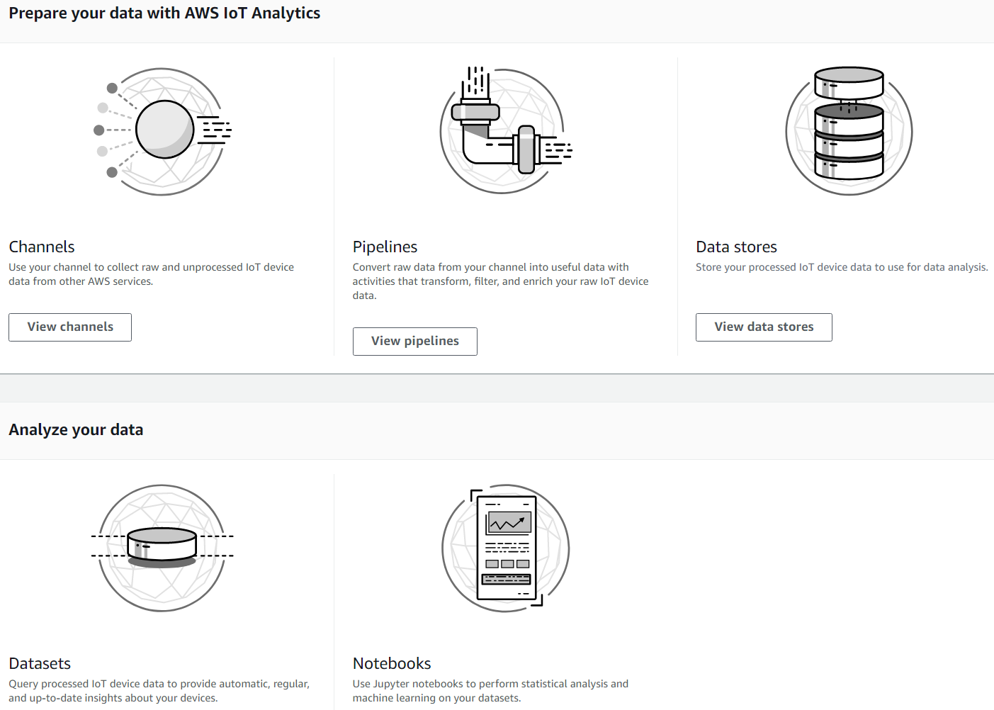
IoT Analytics in its Full Generality
https://console.aws.amazon.com/iotanalytics/v2/
Notes:
AWS IoT Analytics Pipelines would be where data transformation, supplementation, and filtering (i.e., processing of the raw data) would be done. The SQL query at the Dataset stage could potentially also do some processing and filtering. True analysis would seem to be reserved for Notebooks, but I’m not sure the results would make their way back into the dataset.
Pipeline activities can enrich or transform message attributes or filter out entire messages. Can chain activities together. Pipeline activities affect message contents before they are stored in the data store. Activities are added to the pipeline one by one from the console.
Can refresh a dataset with a specified frequency (via a cron expression) using SQL queries against the data store. But not in real-time, however; would probably need to use something like Amazon Kinesis for that.

Slide 38
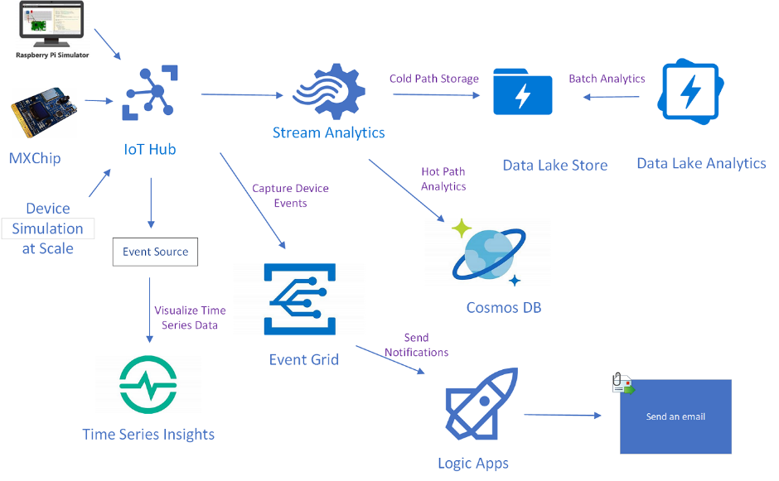
Brief Azure IoT Experiment
Used Azure free tier subscription for IoT Hub in the cloud
Used IoT Python SDK on Raspberry Pi
Unlike AWS, Azure has a Web-based Raspberry Pi IoT simulator
https://medium.com/pea-hive-platform/getting-started-azure-iot-hub-32b9732486
Notes:
I both used the Web-based simulator for testing purposes and ran Azure IoT code on a real Raspberry Pi 4, but with simulated temperature and humidity sensor results using SimulatedDevice.py from the Azure IoT Samples repo on GitHub.
Azure Raspberry Pi simulator uses Node.js.
https://azure-samples.github.io/raspberry-pi-web-simulator/

Slide 39
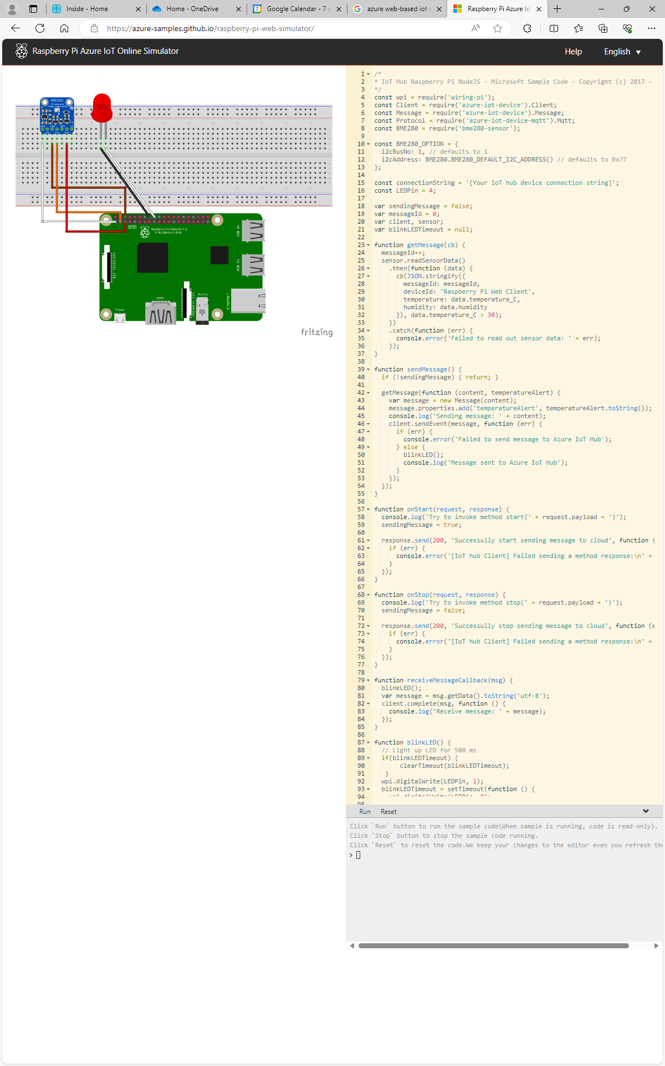
Azure Raspberry Pi Simulator
Notes:
https://azure-samples.github.io/raspberry-pi-web-simulator/

Slide 40
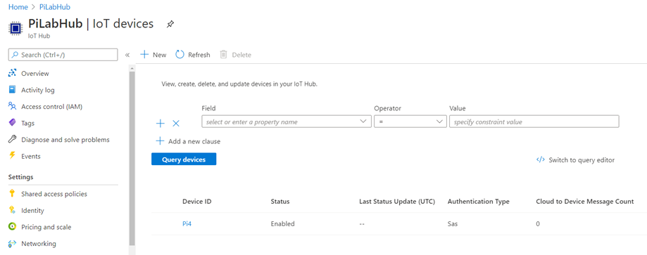
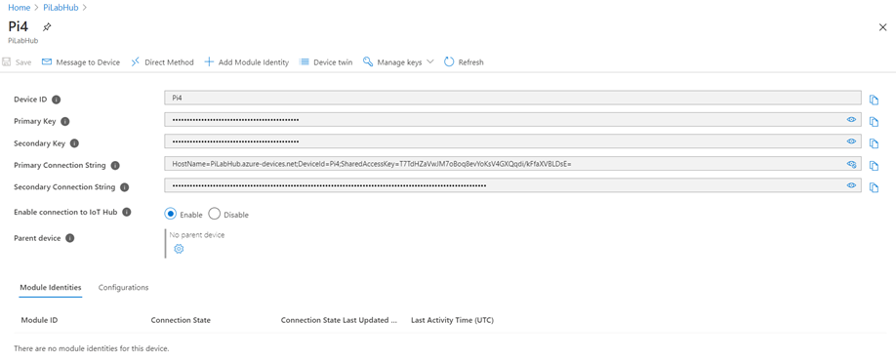
Azure IoT Configuration
Notes:
The instructions came from this blog:
https://docs.microsoft.com/en-us/azure/iot-hub/quickstart-send-telemetry-python
Create a resource group in the Azure cloud; create an IoT Hub in that resource group; and create an IoT Device for the Raspberry Pi in that IoT Hub. Choose the Free option for the IoT Hub, which is limited but sufficient for a prototype.
Record the primary connection string for the IoT device, which will be used by the SimulatedDevice.py Python program on the Raspberry Pi to communicate to the virtual IoT device in the IoT Hub in the Azure cloud. The sample program comes from an Azure IoT Samples repo on GitHub.
Azure uses connection strings for IoT device authorization. AWS uses PKI certs.

Slide 41
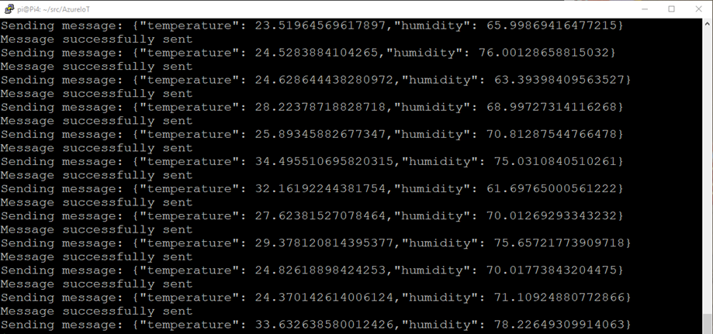
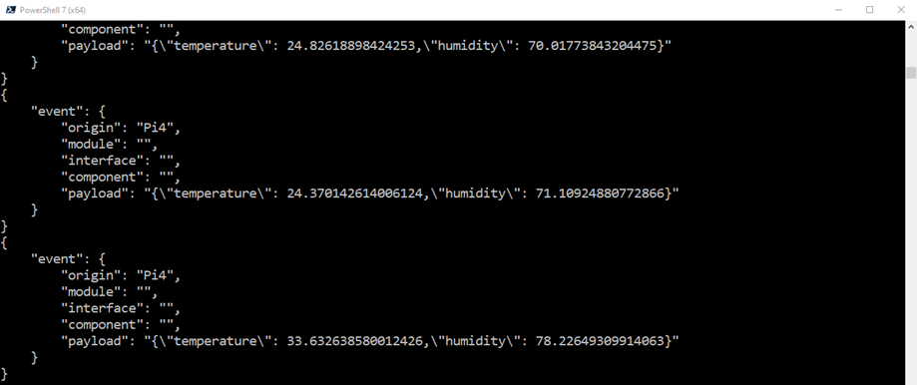
Azure IoT Input and Monitoring
Notes:
Output of simulated sensor program on Pi 4 on the top; output of monitor command in the cloud on the bottom, to verify that what was sent was actually received in the cloud.
Either using Cloud Shell from the Azure Portal or the Azure CLI from a Windows machine, install the azure-iot extension. May need to update to the latest version of the Azure CLI first. Then issue a command to start monitoring any traffic being sent to that IoT device in the Azure cloud.
On the Raspberry Pi, use pip3 to install several azure-iot modules. Update the sample Python telemetry program (SimulatedDevice.py) to contain the primary connection string for the IoT device. Run the program using Python 3.

Slide 42
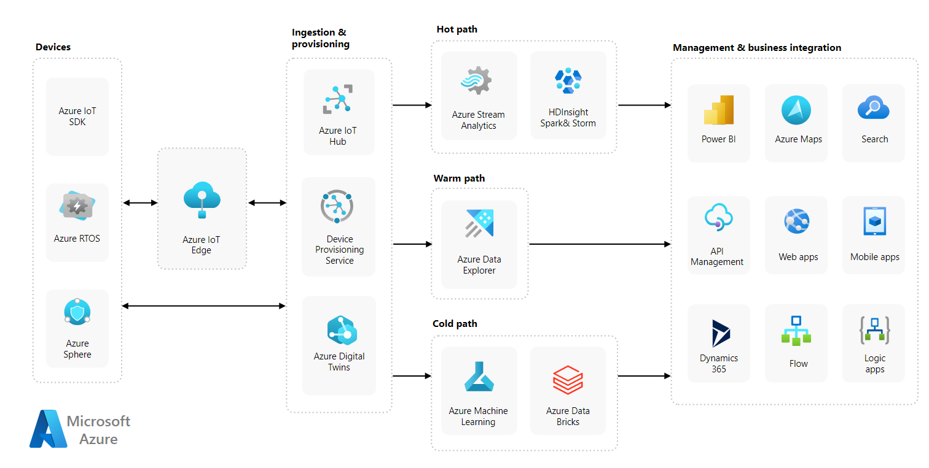
Azure IoT Reference Architecture
https://learn.microsoft.com/en-us/azure/architecture/reference-architectures/iot

Slide 43
Edge Computing

Slide 44
Edge Computing in AWS
As is the case with IoT Computing, AWS has a rich set of Console-based Edge services and device SDKs for several languages
Greengrass is the SDK for AWS Edge Computing, which comes bundled with the AWS IoT Device SDK
Special configuration of Edge device required
I used v1.11 of the Greengrass Python SDK; v2 has a very different architecture.
v2 is Java-based and incomplete (at the time of the project)
Seems more abstract and complex than v1
Notes:
James Gosling, of Sun Microsystems Java fame, heads up v2.0 of the AWS Greengrass SDK, which explains a lot.
The Greengrass SDK requires special configuration of the Edge device in order to run. AWS provides a dependency checker utility to help prepare the Edge device for Greengrass.

Slide 45
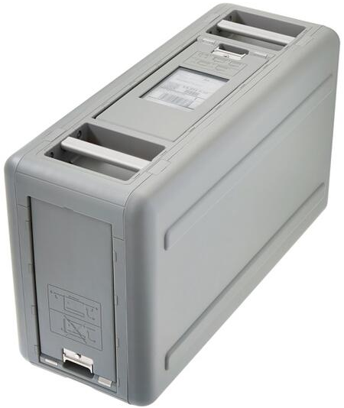
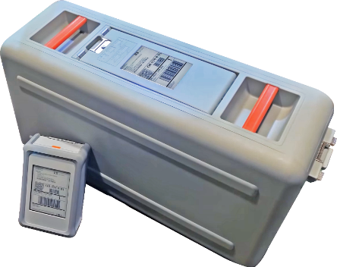
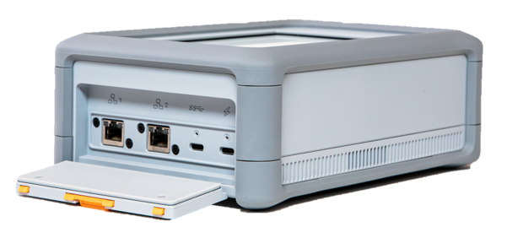
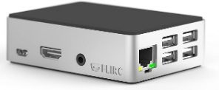
Popular AWS Edge Devices
Size comparison
AWS Snowball Edge
AWS Snowcone
Raspberry Pi 4
Notes:
Can also use the AWS Partner Device Catalog shown earlier for a complete list.
Top middle picture shows the relative sizes of the Snowball Edge and Snowcone.
Though the Snow devices can use Greengrass for Edge computing, it is perhaps more common for them to run EC2 (Elastic Compute Cloud) VM instances, to use NFS in the field to transfer data into the file system on the device, to use the EC2 instances to process that data and leave the results on the file system, and for that data to be stored in a specified S3 bucket when the device is returned to AWS. Video transcoding in the field is one canonical use case documented on the AWS blogs. Another use of Edge devices of more potential applicability to Sandia is data processing in theatre.
Note that the Raspberry Pi cannot run EC2 instances but can run Lambda functions at the Edge.
Email trail with Rick Strong follows:
So, if you're into this sort of thing, I have to recommend:
https://www.youtube.com/watch?v=LabltEXk0VQ
That might be one of the best re:Invent presentations ever (and also the best explanation of virtualization that I shamelessly copy). Amazing explanation of their evolution of the hypervisor.
If you want to tumble further down the rabbit hole:
https://www.youtube.com/watch?v=e8DVmwj3OEs
Crazy implications of how "nitro" is overloaded and how is it is basically custom silicon *everywhere*.
So going full circle, the implication of my question is, depending on how they did this, this could be the first instance of nitro cards (and/or hypervisor) that exists outside of AWS space.
Fun times!
--Rick
From: Linebarger, John Sent: Monday, March 29, 2021 5:55 PM To: Strong, Richard James Subject: Re: Weird Follow-Up (sort of answering the question)
FYIW, before AWS cut over to its proprietary Nitro hypervisor, they used to use Xen. Not sure if that's what they put on the Snowball Edge/Snowcone for old time's sake.
From: Strong, Richard James Sent: Monday, March 29, 2021 1:04 PM To: Linebarger, John Subject: Weird Follow-Up (sort of answering the question)
Like all questions, this answer actually generates more questions.
From Docs here:
https://docs.aws.amazon.com/snowball/latest/snowcone-guide/snowcone-before-ordering.html
Implication is X86 + HVM. “HVM” doesn’t imply anything useful (other than HW accelerated virtualization), so it would be fun to get one of those and see what hypervisor under the hood is providing things.
--Rick

Slide 46
AWS Edge Computing Architecture
MQTT (Message Queuing Telemetry Transport) pub/sub messages
Device-specific PKI certs / IAM policies
Devices are aggregated into a Greengrass Group that has a known Edge device, called a Greengrass Core
All devices must be able to find the Core
A message subscription table controls all interactions
Edge device invokes key AWS services with Connectors via MQTT, not API calls
Sensitive parameters are stored in AWS Secrets Manager and retrieved by Edge
The Greengrass Core device is the MQTT broker
Connectors let Edge device talk to key cloud services
Notes:
By contrast, in IoT Computing, all each device has to do is to find the cloud (through a unique Endpoint).
CloudWatch connector batches transmission of metrics, which leads to posting delays. Also has bugs, which were reported to, and verified by, AWS Support.
Connectors seem to have been replaced by Components in v2 of the Greengrass SDK.

Slide 47
Edge Computing Prototype
Requires Serial Peripheral Interface (SPI) protocol support on the Raspberry Pi
Two Raspberry Pi 3 B+ devices with analog water level sensors send data to Edge device
Edge device (Pi 4) aggregates, forecasts, sends metrics, SMS texts
CloudWatch Dashboard monitors in cloud
Emergency Alarm:
X% of devices above Y% water level threshold
Warning Alarm:
One or more devices forecasted (through linear regression in scikit-learn) to exceed threshold within the next Z minutes
All alarms displayed on Dashboard, phone text (SMS), email (SNS)
Notes:
Parameters come in as environment variables to the Lambda function
SMS – Short Message Service
SNS – Simple Notification Service (AWS)

Slide 48
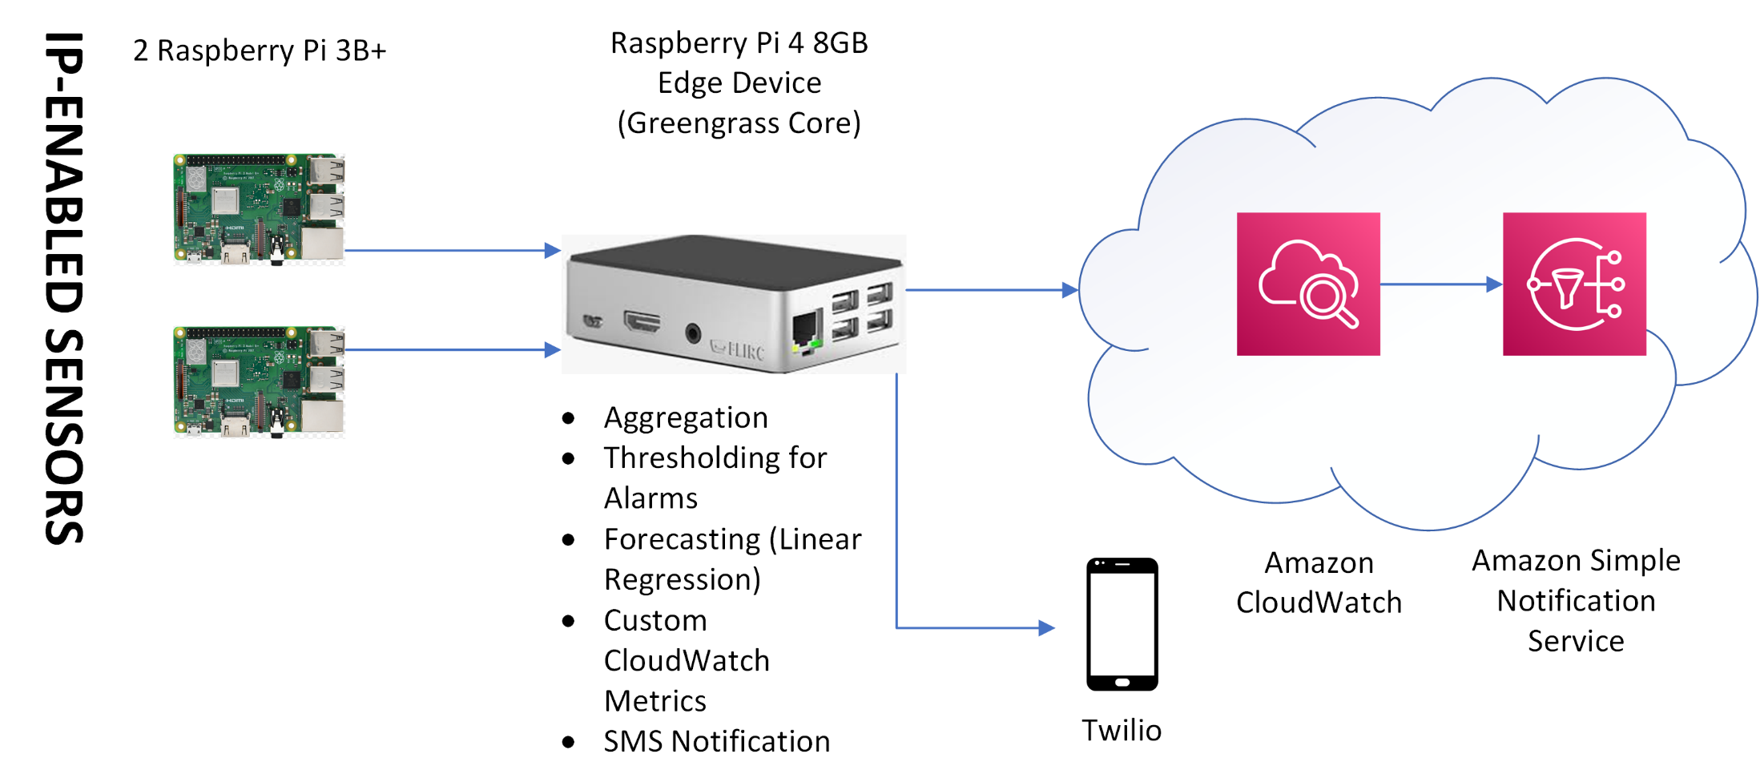
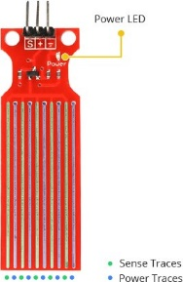
Edge Prototype Architecture
HW-038-compatible analog water level sensor
Notes:
Note that it would have been simplest if the SNS topic was subscribed to via an SMS text message. However, the CloudWatch connector on the Edge device does batching of some sort, so it can take a bit of time for the metrics to actually be reported to CloudWatch in the cloud. By contrast, sending a Twilio SMS text message using the Twilio connector at the Edge was almost instantaneous.

Slide 49
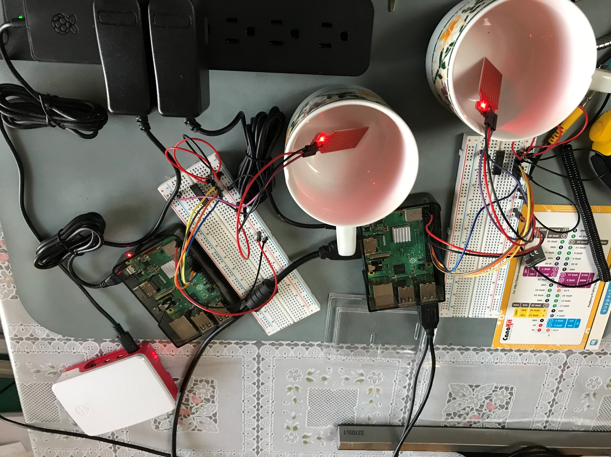
Raspberry Pi Edge Computing Lab
Notes:
Breadboard needed for A2D conversion

Slide 50
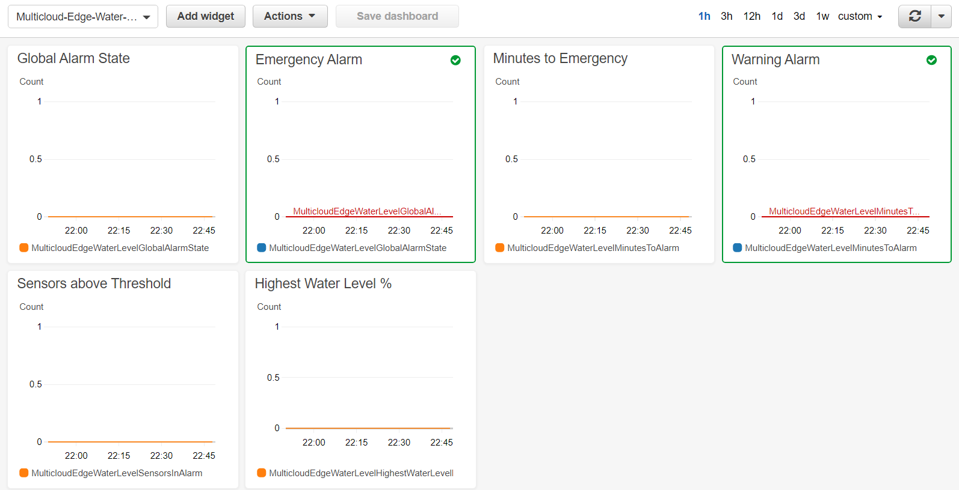
Results: Normal Dashboard
Notes:
CloudWatch Dashboard with custom CloudWatch metrics

Slide 51
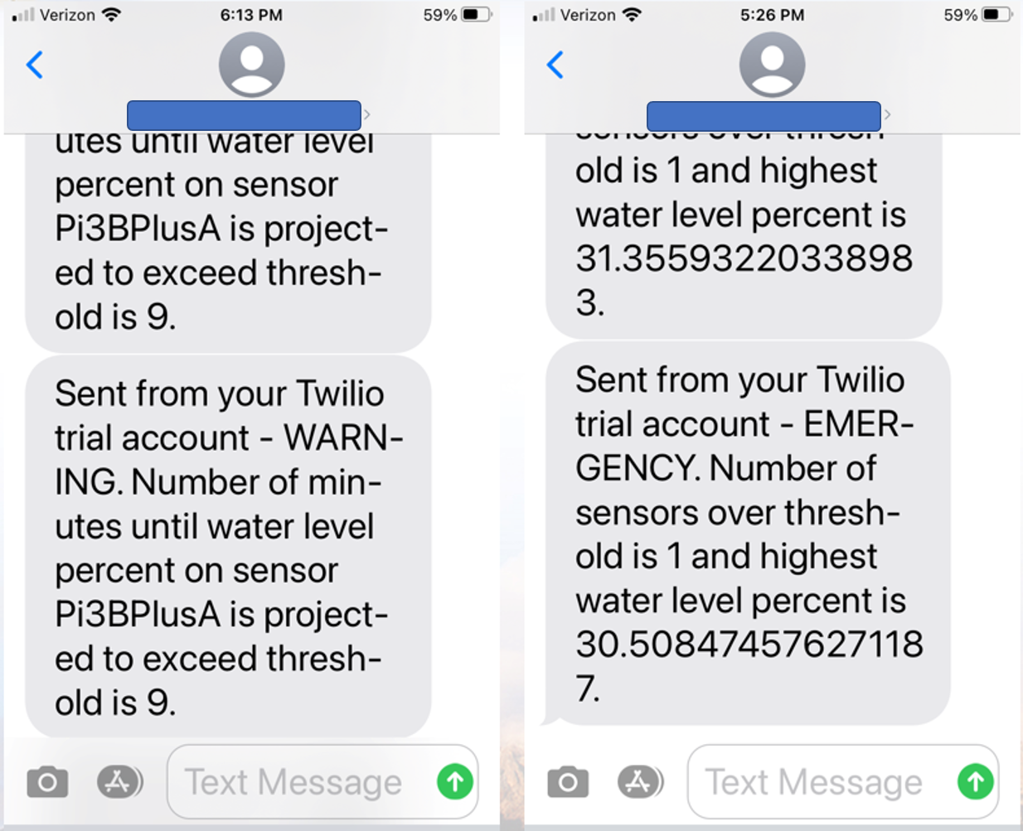
Results: SMS Text Messages
Notes:
SMS (Short Message Service) texts sent through a Twilio trial account for the purposes of the prototype

Slide 52
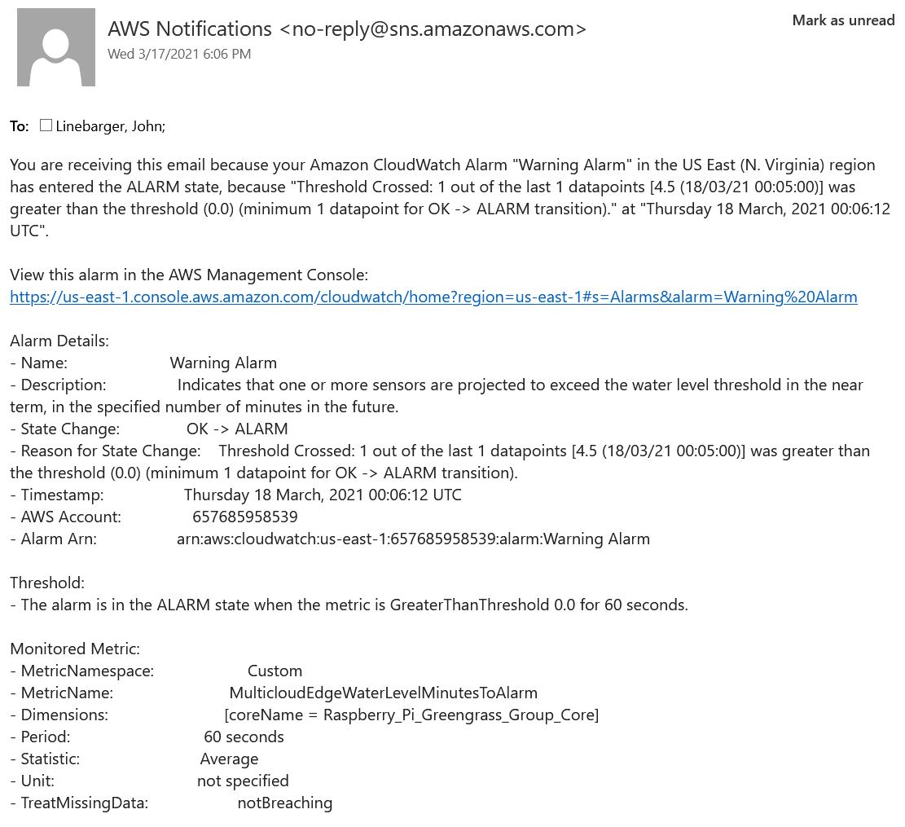
Results: Warning Alarm Email

Slide 53
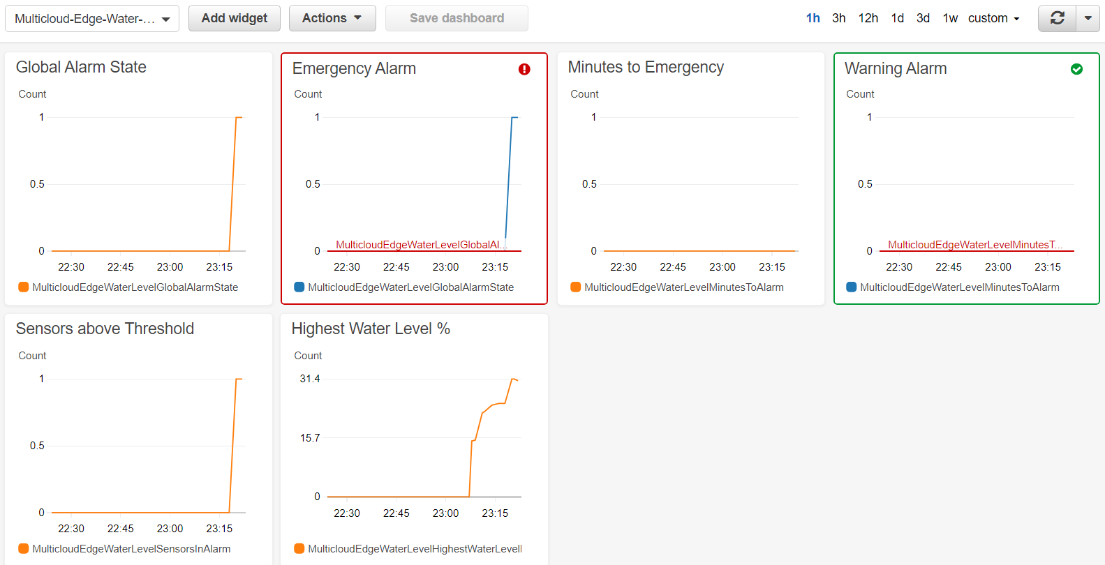
Results: Emergency Alarm Dashboard
Notes:
Represents a flood situation with no warning because the rise was so rapid.

Slide 54
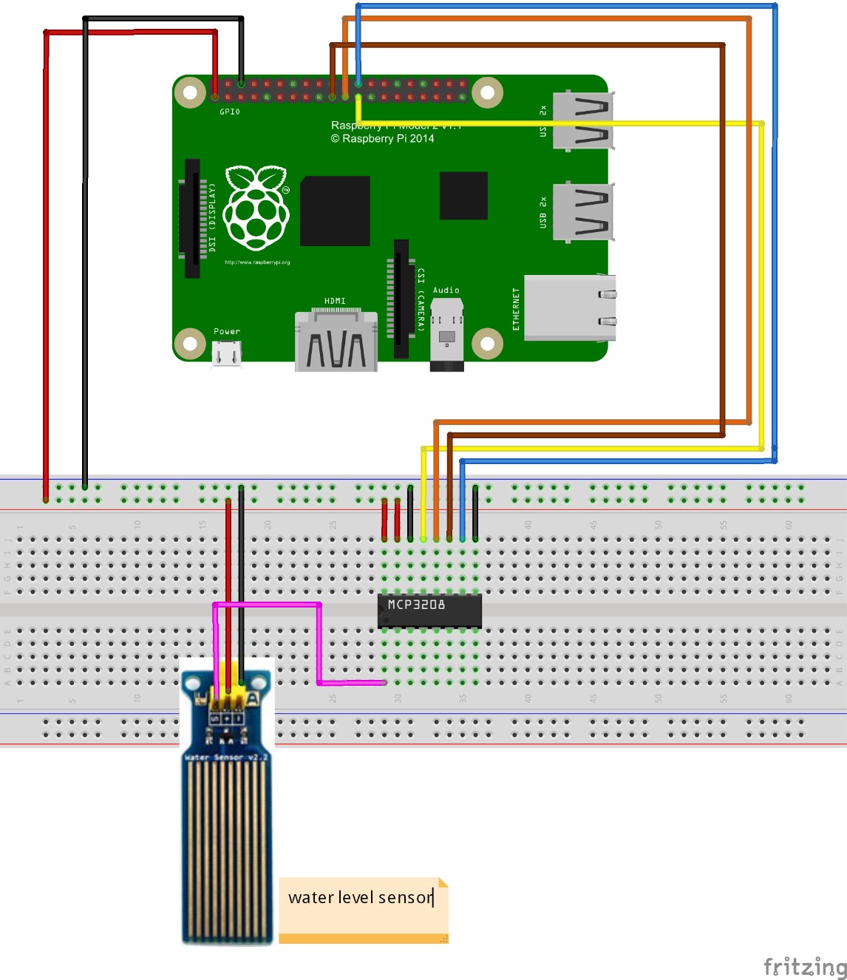
Mechanics: Analog-to-Digital
https://kookye.com/2017/06/01/design-a-water-level-detector-through-a-raspberry-pi-board-and-water-level-sensor/
Notes:
Arduino microcontroller (control-loop-only) supports analog and digital sensor inputs while Raspberry Pi microcomputer (general purpose computer) supports only digital inputs.
Water level sensors are analog devices.
The analog (rain) water level sensor was a “classic” one like the HW-038:
https://www.alibaba.com/product-detail/HW-038-water-level-sensor-droplet_62317258231.html
https://www.amazon.com/DGZZI-Surface-Detection-Arduino-Raspberry/dp/B08C7L7GBK/
Analog water sensor used an SPI (Serial Peripheral Interface) because the pins came in from the A2D converter (though my actual sensor was not an FC-28 as in the article below):
https://maker.pro/raspberry-pi/tutorial/interfacing-soil-moisture-sensor-with-raspberry-pi
Raspberry Pi has to be configured to support SPI.
Good tutorial on the basics of A2D:
https://www.youtube.com/watch?v=0y8AD8maAHo

Slide 55

Mechanics: Non-Linear Calibration
https://shop.rasp.io/products/rain-water-level-detection-sensor
Notes:
(Rain) water level sensor is powered with 5V pin, 40mm long, which I manually calibrated at quartiles (every 10mm) and programmatically interpolated sensed values within a quartile. Close enough for my purposes.
https://www.gearbest.com/development-boards/pp_70484.html
The HW-038-compatible water level sensors are not very accurate and ideally should be calibrated for each run. Calibration values can even change during a run. They are commodity devices for hobbyists, not industrial-strength devices for professional use. Not sure if the two-pronged FC-28 soil moisture sensor (as opposed to the rain water level sensor that I used) is any better.
Great discussion of the science of water level sensing:
https://lastminuteengineers.com/water-level-sensor-arduino-tutorial/

Slide 56

Mechanics: Stateful Lambda Function
Notes:
Lambda functions are normally used for (stateless) serverless computing and run in anonymous Firecracker VMs, but in Edge computing the server is known.
The flow is to code the Lambda function in the cloud and deploy to the known Edge device (Greengrass Core). Configure as a long-lived function (which will be kept running indefinitely). Can invoke other programs installed on the device.
As always, this Lambda function has access to the /tmp directory on the file system, although it is relocated and buried evidently to map to a Greengrass container. (Meaning, it is not the actual /tmp directory on the Edge device.)

Slide 57

Mechanics: Debug Lambda Function
Notes:
Two debugging options, depending on how you configure the Lambda function in IoT Core: local logs (one for system, one for “user” [meaning, the Lambda function itself]) on the Edge device file system, and CloudWatch Logs (pictured).

Slide 58

Mechanics: MQTT Subscription Table
Notes:
MQTT messages must be authorized with the subscription table. Otherwise they wouldn’t be accepted by the receiver.
This is a pain to recreate whenever the Lambda function version changes, before redeploying to the Edge device.
Another pain was the debugging cycle whenever the Lambda function changed. Took on the order of an hour (update Lambda function, create new version, recreate subscriptions, reset deployment, deploy, execute, debug using the local logs) just to debug a simple syntax error. Finally developed a way to test the Lambda function locally on the Pi 4 to rapidly fix syntax errors locally. Prototyping using a Jupyter notebook was helpful too.

Slide 59

Mechanics: Test Client for Edge
Notes:
Cloud-based IoT test harness
JSON messages sent using the MQTT protocol

Slide 60

Mechanics: Group IAM Role / Policies
Notes:
IAM: AWS Identity and Access Management
Seems to control what the Lambda function at the Edge can do in the cloud
There is also an IAM policy associated with the certificate for the Greengrass Group Core Thing (well, all of the Things), but I’m not completely sure how that functions. It allows “greengrass:*” though.

Slide 61
Flood Control System Proof-of-Concept (Non-Cloud-Based)

Slide 62

Network Architecture
JSON messages sent over MQTT
Broker Pi is wired to router. Every other Pi is wireless.
Thresholding (flood detection) and alerting
Notes:
JSON: JavaScript Object Notation

Slide 63

Quadrant Sensors on Upper and Lower Floors
Notes:
Four sensors each that represent the quadrants of an upper story and a lower story of the same building

Slide 64
Sensor and Camera in Utility Room
Notes:
One sensor plus camera that represent a utility room in the same building which contains a lot of water pipes.

Slide 65


Text Alarm and Emailed Utility Room Photo

Slide 66
Q&A

Slide 67
Backup

Slide 68

Mechanics: scikit-learn Forecasting
Regression (fit model to recent historical data)
Prediction (near-term extrapolation)
Notes:
Scikit-learn is a popular open-source Python machine learning library.
Forecasting done at the Edge instead of in the cloud. The overall goal is to be able to trap and report a slow leak situation before it ever becomes a flood.
In this case, real-time forecasting is done at the Edge; can conceptualize as supervised learning where the training set consists of all historical data and the test set can be considered the extrapolation projections into the future. In other words, I implemented a supervised learning model where the entire recent history of water level measurements is the training set. In a formal sense there is no true test set in the conventional sense. Near-term projection is done by calling scikit-learn to extrapolate values for timestamps in the future.
Seconds since epoch is used as the timestamp representation for the independent variable.
Alternative would be to statically train a SageMaker model in the cloud and run it on the Edge device using SageMaker Neo. But I wanted to retrain the model (i.e., calculate a different linear regression line to use for forecasting/extrapolation) with every single sensor reading.
Used a Jupyter Notebook to interactively experiment with the scikit-learn forecasting (linear regression) code before putting it into the Lambda function on the Greengrass Core.
Had real difficulty installing scikit-learn on the Pi 4. Kept getting binary incompatibility errors. Ended up reinstalling it using a version of a pip command that rebuilt the entire thing from source. This took a very long time but solved the problem.
scikit-learn perhaps could have been installed instead as a Lambda layer. (This might even have been the best approach, in hindsight.) The approach I took worked because Greengrass is evidently invoking a Python interpreter on the Edge device in order to run the Lambda function.

Slide 69

Mechanics: Jupyter Notebooks
Notes:
I used a Jupyter Notebook for interactive development of scikit-learn code.

